Slide 1
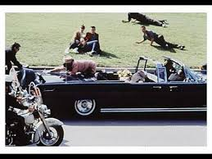
CONSIPIRACY THEORIES

Slide 2
http://www.history.com/topics/warren-commission/videos/jfk-assassination-conspiracy-theories

Slide 3
WARREN COMMISSION
A week after President John F. Kennedy was assassinated in Dallas, Texas, on November 22, 1963, his successor, Lyndon Johnson (1908-1973), established a commission to investigate Kennedy’s death. After a nearly yearlong investigation, the commission, led by Chief Justice Earl Warren (1891-1974), concluded that alleged gunman Lee Harvey Oswald (1939-1963) had acted alone in assassinating America’s 35th president, and that there was no conspiracy, either domestic or international, involved. Despite its seemingly firm conclusions, the report proved controversial and failed to silence conspiracy theories surrounding the event. Subsequent investigations have both supported and called into question the Warren Commission’s report.
Historychannel.com

Slide 4
1 Shooter, 3 Shots ????

Slide 5
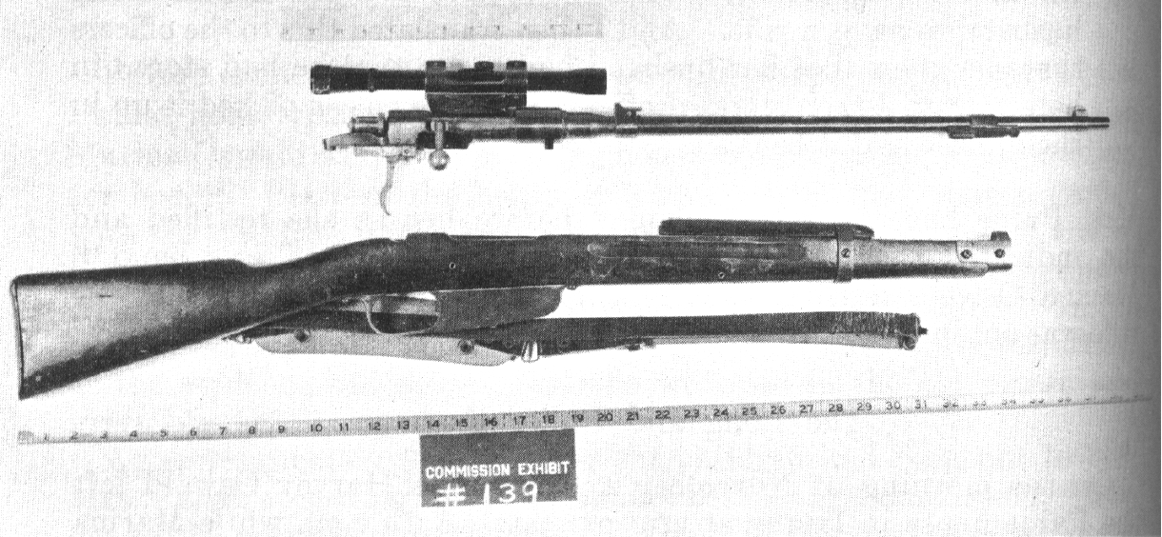
6.5mm Carcano Carbine rifle (partial palm print of Oswald)
Did he have enough time to load and discharge 3 times?

Slide 6
Magic Bullet

Slide 10
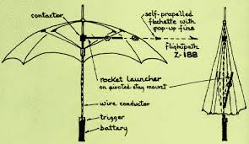
The Black Umbrella

Slide 11
By Standers?

Slide 13
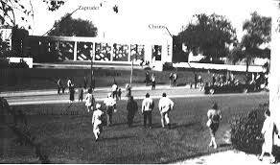

Slide 14
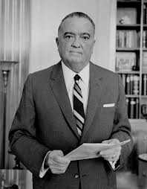
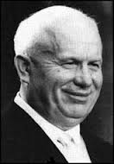
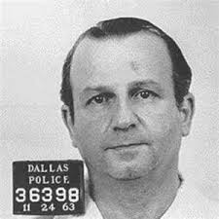
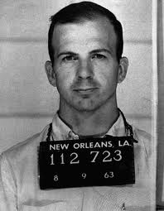
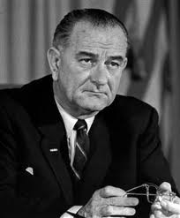
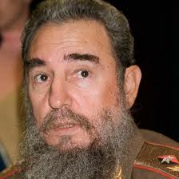
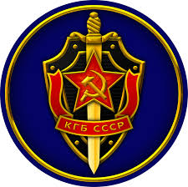

Slide 15
What is so shady????
It’s 2-fold:
1. Suspicious series of events and testimony about what happened November 22, 1963 in Dallas
Questionable people there
Contradictory witness testimony – where the shots came from, how many there were, Grassy Knoll
Interpretation of the evidence
How the evidence was collected, autopsy was performed, what happened to the body
The probability of the interpretation of the evidence – “magic bullet”? 3 shots that fast?

Slide 16
So many motives…. A tangled web
2. Did Oswald do it “just because”?
Mob had it in for Kennedy (Senate investigation of Giancana, Hoffa…)
CIA had a reputation of doing things under the table
Johnson allegedly had ties to big business who wanted JFK out
Castro wanted JFK out because he saw him as a huge threat to the success of his revolution
Soviets wanted JFK out
Oswald working for the KGB?
Ruby working for KGB or CIA to keep Oswald quiet?

Slide 17
CUBAN MISSILE CRISIS
KHRUSCHEV EMBARASSED
OSWALD DEFECTED TO USSR
- Claims of Oswald linked to KGB
- Oswald’s wife was Russian

Slide 18
CIA
BAY OF PIGS
MAFIA
Mafia had $ in Cuba
Mafia had ties to CIA
Deal between CIA and Mafia: CIA assassinates Castro, Mafia assassinates JFK
Bay of Pigs ended any hopes of US/Cuba to mend relations (and Mafia get back into Cuba)
Mafia had it in for Kennedy brothers

Slide 19
Mafia
Jack Ruby
Oswald
(patsy)
Marxism
(Rejected)Cuban Citizenship
Oswald proving himself

Slide 20
Johnson:
Next in line to be president
Supported by oil interests/wealthy businessmen (special interests)
Aided by George H. W. Bush…
CIA:
Plays a part in virtually all of the theories
“Secret”
“Red Scare” paranoia (wire tapping, J. Edgar Hoover…)
Reputation for assassinations
Oswald was an agent? No.

Slide 21
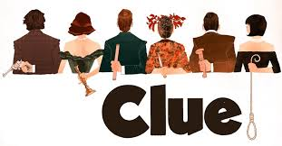
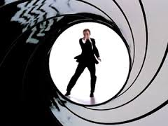
WHO DID IT????

