Slide 1
Cuban Missile Crises
US History 11
Spring 2012

Slide 2
Bay of Pigs
Kennedy was presented with a plan when he became President of the United States
Goal was to stop communism in Cuba
CIA guaranteed it would be an “easy” win

Slide 3
The Bay of Pigs
An unsuccessful attack on Cuba
Designed to overthrow the communist government of Fidel Castro
April 17th ,1961
Cuban refugees trained by U.S. in Guatemala to fight Fidel
CIA advised Kennedy to attack
Video

Slide 4
The Arms Race
By 1962 the United States was ahead
United States
Technology was capable of launching nuclear weapons against Soviet Union
(From England, France or Turkey)
Soviet Union
Only had technology to launch nuclear weapons to Europe

Slide 5
Fidel Castro
Leader of Cuba
Communist government
Allied with the Soviet Union
Unfriendly with the United States due to the Bay of Pigs

Slide 6
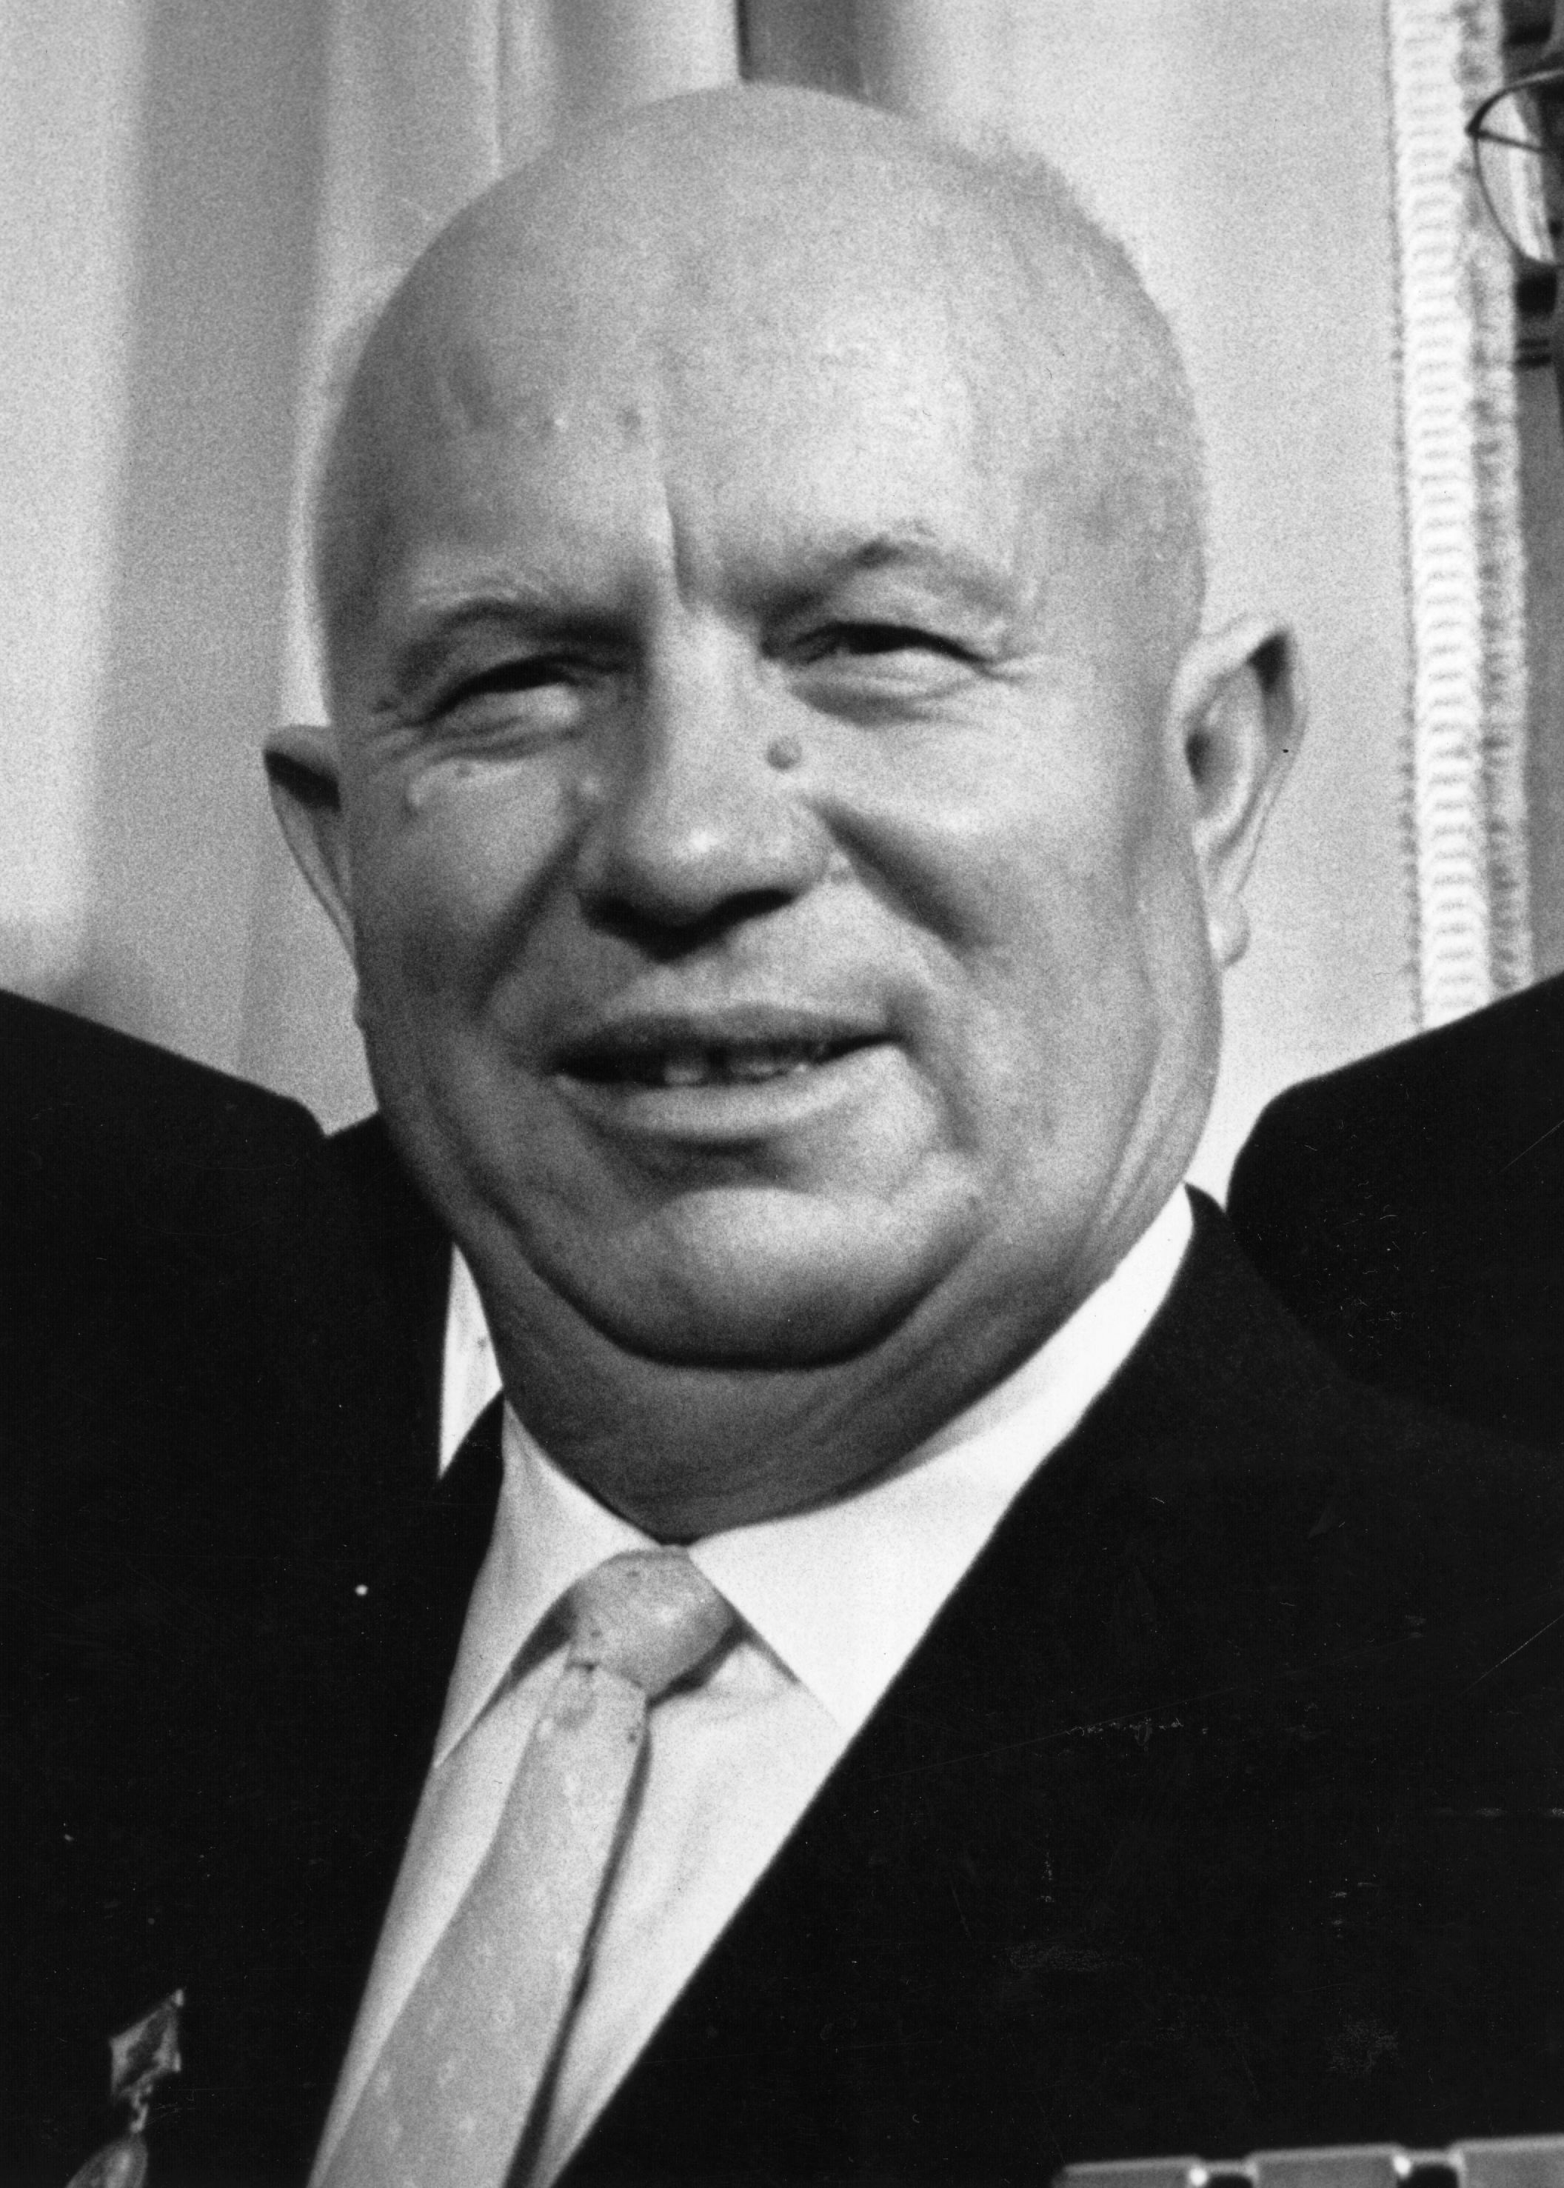
Soviet Missiles in Cuba
Nikita Khrushchev
Soviet Premier
Suggests intermediate range missiles in Cuba to advance the Soviet Union in the Arms Race
Fidel Castro agrees
Sees suggestion as a way to defend Cuba if the US were to try to attack again
Summer of 1962 Soviet Union secretly built missile instillations in Cuba

Slide 7
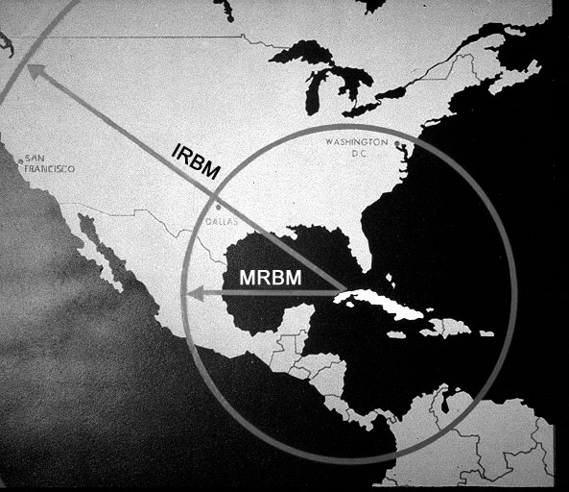

Slide 8
United States Reaction
Kennedy is informed about the possibility of Soviet missiles in Cuba – Aug. 1962
Intelligence is pretty sure, but Kennedy wants PROOF!

Slide 9
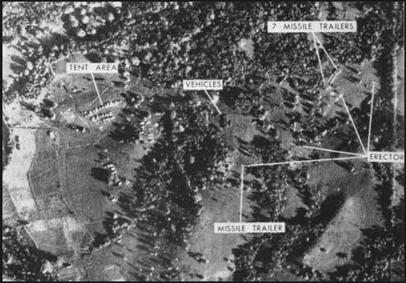
US Reaction (cont.)
October 14th 1962
US U-2 reconnaissance flight confirms presence of Soviet missiles in Cuba

Slide 10
Kennedy & EX-COMM
EX-COMM
(short for Expert Committee)
A group of Kennedy’s 12 most trusted advisors
Oct 16th - Discuss possible diplomatic & military courses of action
Meetings kept secrete for 7 days
The U.S. has time to make decision

Slide 11
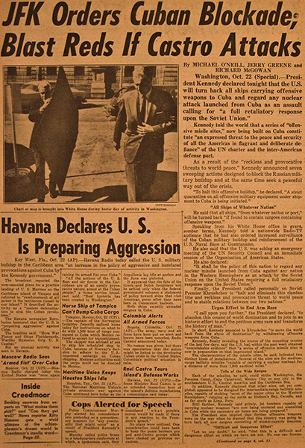
US Course of Action
Oct 22nd – Kennedy announces presence of Soviet missile in Cuba to the American public
Imposes a Naval quarantine around Cuba
Demands Soviet Union remove all missiles from Cuba

Slide 12
Soviet Reaction
Oct 26th 1962
Khrushchev sends letter to Kennedy
Purposed removal of missiles from Cuba if United States promised not to attack Cuba and remove missiles from Turkey
This would be done secretly!!!

Slide 13
Climax of the Crisis
October 27th 1962
U-2 Shot down over Cuba
Khrushchev sends second letter
Demands removal of US missiles from Turkey publicly, and public promise never to attack Cuba.

Slide 14
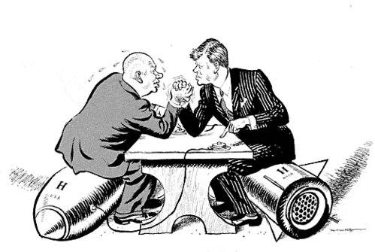
US Reaction
US has a problem:
Wants Soviet missiles out of Cuba
Does not want the world to think the United States was weak
Attorney General Robert Kennedy suggests ignoring the 2nd letter & agreeing to the 1st letter

Slide 15
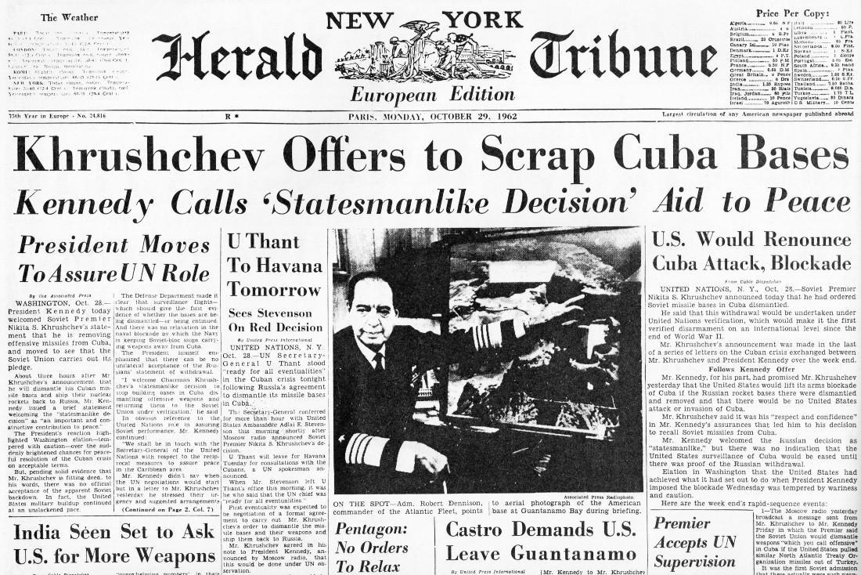
Crisis Averted
Oct 28th 1962
Khrushchev announces that the Soviet Union will remove the missiles if the US would not attack Cuba

Slide 16
End Result
United States is now safe
Soviet Union is now safe
Cold War thaws – Agreement between Kennedy and Khrushchev
World almost completely destroyed
Embargo of Cuba

