Slide 1
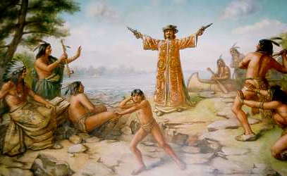
First Contact
Exploration and Exploitation

Slide 2
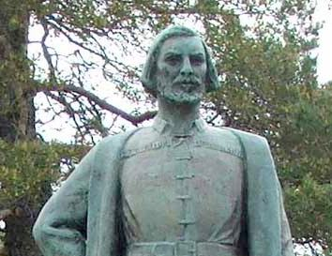
1634 on the Shores of Lake Michigan
Ho-Chunk, Menominee, Potawatomi
Various camps near Green Bay
Jean Nicolet
White French Fur Trader
In canoes
Gifts
Thunder Sticks
Sent by Governor of New France in North America – Samuel de Champlain
Negotiate peace between Ho-Chunk and Ottawa
Grow trade in Northwestern Great Lakes

Slide 3
Welcome
Ho-Chunk prophesy of “light skinned hairy ones”
Sprinkling tobacco on Nicolet’s head as sign of honor
Not sure how “unexpected” the Europeans were
Already in the NE
Trade routes between tribes

Slide 4
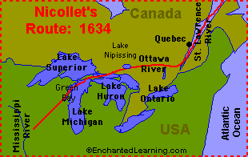

Slide 5
Early Conflicts
French and the Algonquians versus Dutch and Five Nations
Trade competition & War
Resulted in displaced people
Pushed to western Great Lakes from the northeast
i.e. Sauk, Mascouten, Potawatomi & Kickapoo moved west & north from southern edge of Lake Michigan
Ojibwe, Ottawa, Mesquakie & Iroquois speaking (non-Confederacy) tribes moved west into Ho-Chunk & Menominee territory
Pushed Ho-Chunk toward enemy territory

Slide 6
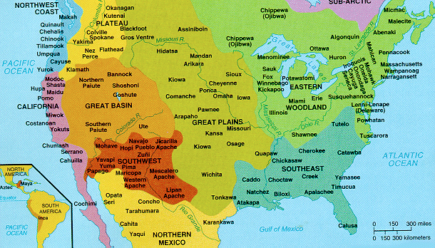

Slide 7
Conflicts between and within
Conflicts centered around competition & alliances
Nicolet was not successful – only temporary peace
Ho-Chunk & Menominee vs. other Algonquin tribes
Ho-Chunk Hardship –
Disease
Lack of resources
10% of Ho-Chunk population pre-Nicolet survived
Resulted in inter-tribal marriages
Peace
Survival
Re-build

Slide 8
Ho-Chunk:
Winnebago name – Algonquin
Referred to stagnant water near their settlements
“the Stinkards”
Siouan origins (language)
Name for selves: Ho-Chunk
Translations
English – Trout People; Big Fish People
Elders today – The People of the Big Voice

Slide 9
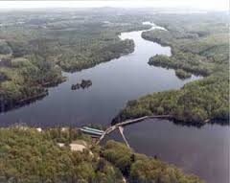
Menominee
Growing population due to other tribes moving in on their territory
Warfare
Less game & fish
Shifting alliances

Slide 10
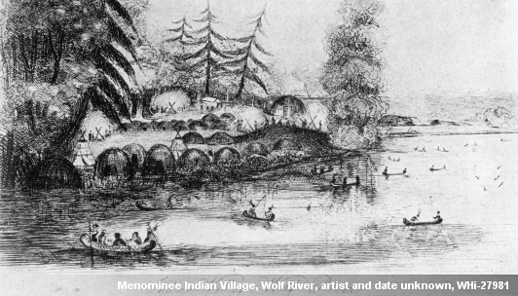
Name – given by Ojibwe, used by Europeans
Mamaceqtaw
Means “rice eaters”
Algonquin
Ojibwe (Chippewa); Fox, Kickapoo (Ashinaabe language family)

Slide 11
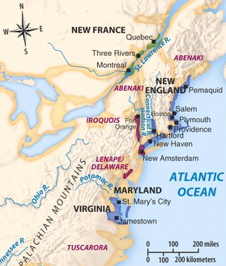
French and the British
First permanent settlements:
English – 1607 Jamestown VA
French – 1608 Quebec
Purpose:
British – individuals
Little government support
Settle, farm, new start
French – traders
Royal Enterprise of fur & conversion to Christianity

Slide 12
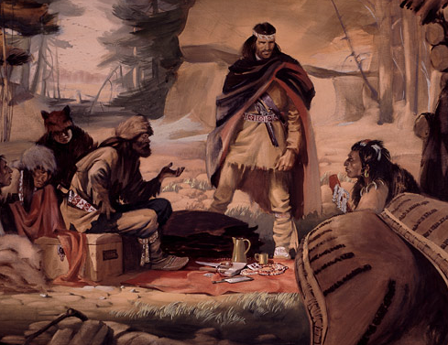
Voyageurs
French focus – trade
Tribes as partners
Learned language
Intermarriage
“cultural absorption”
Voyageurs –
French traders on the Great Lakes waterways
Used native forms of transportation (canoes, snowshoes)
Created Middle Ground

Slide 13
Thunder sticks and devil fish
Affect of European goods
Changed identity of tribes
Ho-Chunk & Menominee (agrarian)
Better farmers with metal tools
Potawatomi & Ojibwe (hunters)
Efficient hunting
Guns = easier to hunt animals and kill people
Deadlier wars

Slide 14
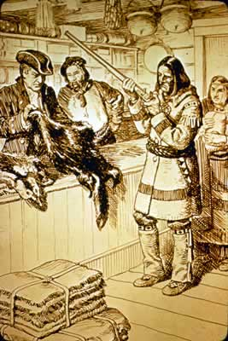
Easy Exploitation
Lives made easier, but more dependent
Raw materials (pelts) worth less than finished goods
Takes more of them
Need more to buy more…
Depleted resources
Tribes broke up into smaller bands

Slide 15
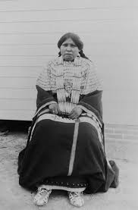
Roles of Native American Women
With men gone longer and farther, the role of women grew
Hard labor
Responsible for feeding village
Potawatomi
Women’s council in each village
Eldest sisters of male clan chiefs
Lead clan “in paths of good”
Laws were 1st approved by the women before going to men’s council

Slide 16
Post-European arrival
Potawatomi relied more on male leaders
Less on women’s council
Power to leaders of hunting expeditions
European gender roles
French preferred dealing with men
Would “appoint” own leader
Favoritism
Created bigger tribal rifts
Didn’t like loose political structure
Rule by consent vs. 1 in charge
Christianity changed marriage
Monogamy vs. Polygamy
Polygamy because of sexual imbalances as a result of wars

Slide 17
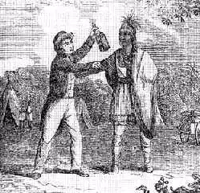
“that great devil-fish upon the sea of human life” - Potawatomi Chief Simon Pokagan
Used in negotiations
Native Americans in the region had never been exposed to it
Manipulated intoxicated Indians
Made existing problems worse
Abuse
Violence
Dependency

Slide 18
Conversion: Jesuit Missionaries 1660s
2nd goal of the French Crown = converting Native Americans to Christianity
Limited success
Too regimented and formal
Believed in a creator, but worked through deities like water, hunting, etc.
Practical; all around
Some converted, though
Vulnerable because so much suffering (disease & war)
Promise of salvation
Awe of Jesuit villages surviving (immune) while Native people died from European diseases
Seen as less respectful than traders

Slide 19
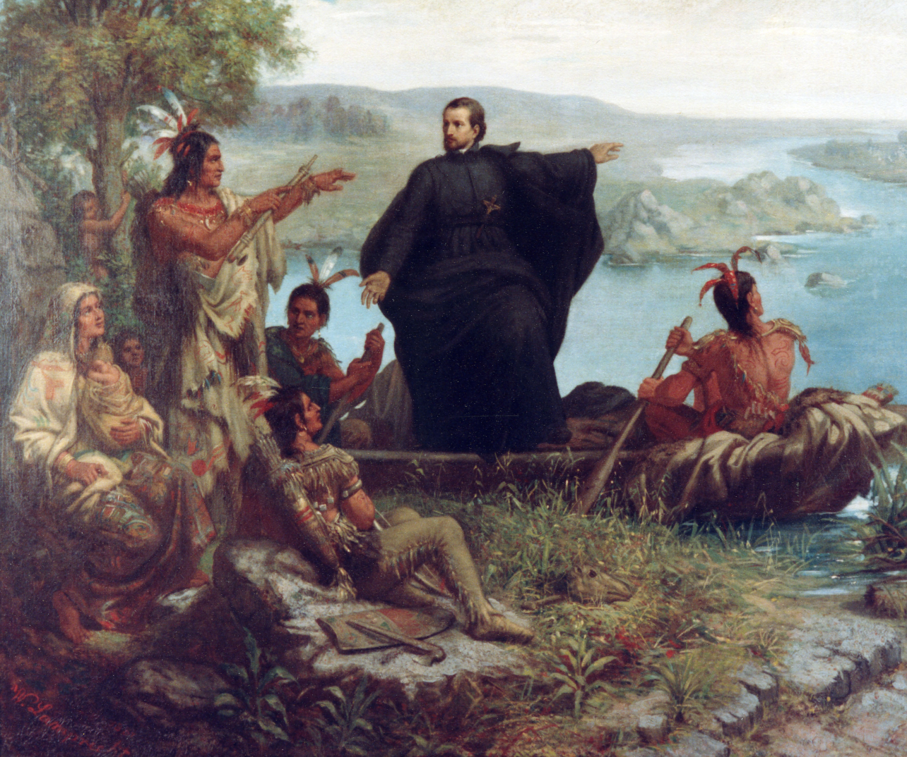

Slide 20
Shifts
Shifts in the Native American confederacies changed
Made getting to Montreal to trade difficult
Unlicensed traders
Success because came to the villages
Didn’t have to make risky trip to Montreal
“coureurs de bois” – woods runners
French view on:
Good – extended influence
Bad – no royalties on trade
Jesuits – coureurs de bois traded alcohol
Economics – too many traders, too much competition, price drops
Needed to get more pelts to buy goods

Slide 21
Door opened for the British…
King Louis XIV forbid coureurs de bois trade, but Native Americans traded with them anyway
French closed forts and consolidated official traders to centers (Detroit)
Tried to get tribes to move
1740s – British took advantage of the French leaving
1753-1759 French & Indian Wars

