Slide 1
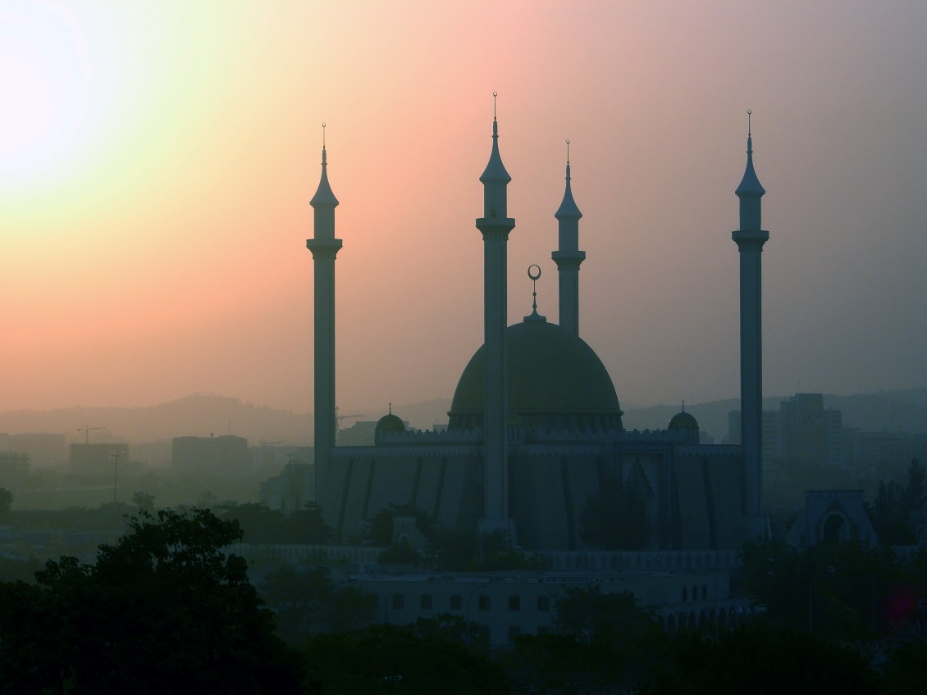
Islam Overview
Background and Rise of the Islamic Empire

Slide 2
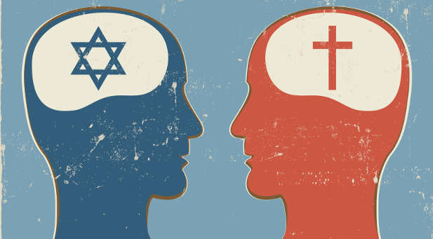
Jesus and Jews
Not the son of God
Then wouldn’t be monotheism
Can’t have more than 1 entity to worship

Slide 3
Abraham
Hagar
Sarah
Ishmael
Isaac
Muhammad
Jesus

Slide 4
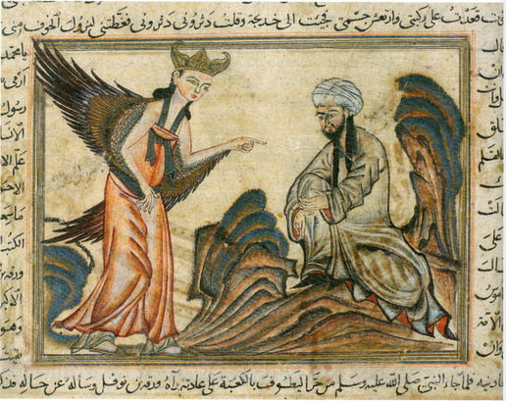
Prophet Muhammad:
Born 570 CE in Mecca to ruling tribe (year 1 of Islamic calendar)
Years of meditation
Message through Angel Gabriel from God in a cave
Continued to receive messages for 23 years

Slide 5
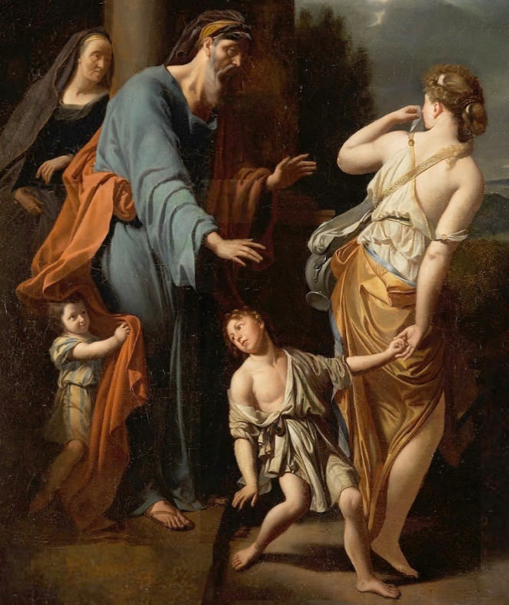
Role of the Prophet Muhammad
Only a messenger – uncorrupted truth
Straight from God
Last prophet
Not the originator – that is God
Islam=“submission” to God
Other prophets before:
Adam, Noah, Abraham, Moses, Jesus
Abraham – father of Jews
Son Ishmael - 1st Muslim
Teachings of early prophets –
Corrupted by other faiths

Slide 6
Qu’ran
God’s word
Prophet’s message
Compiled by Umar (2nd caliph – 634 CE)
On paper (late 800s)

Slide 7
Content of Qu’ran
Length – approx. same as New Testament
Absolute word of God
Poetic form
Molded Arabic literature
Each syllable is sacred
Preferred to be in Arabic – not translated

Slide 8
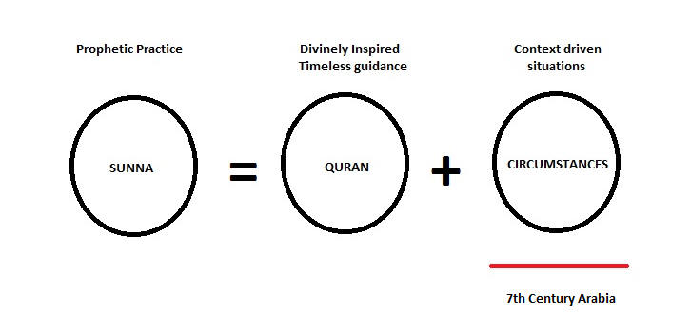
Qu’ran - continued
Basis of:
Faith
Government
Social system

Slide 9
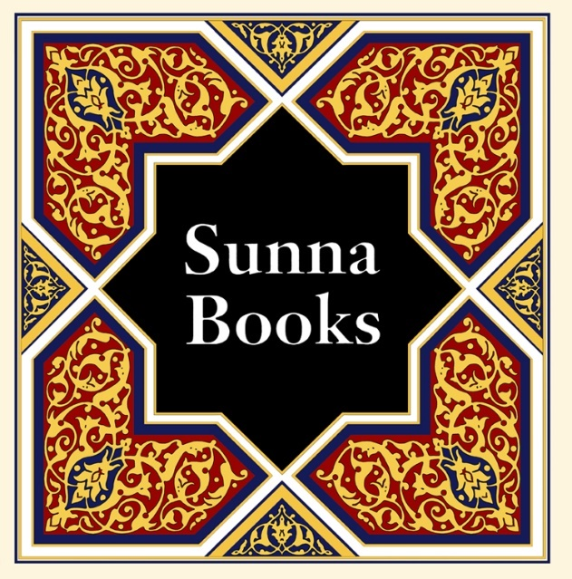
Other Islamic Scripture
Sunna: example of thinking & living set by the Prophet Muhammad
Written in the Hadith
Recorded words and deeds of Muhammad

Slide 10
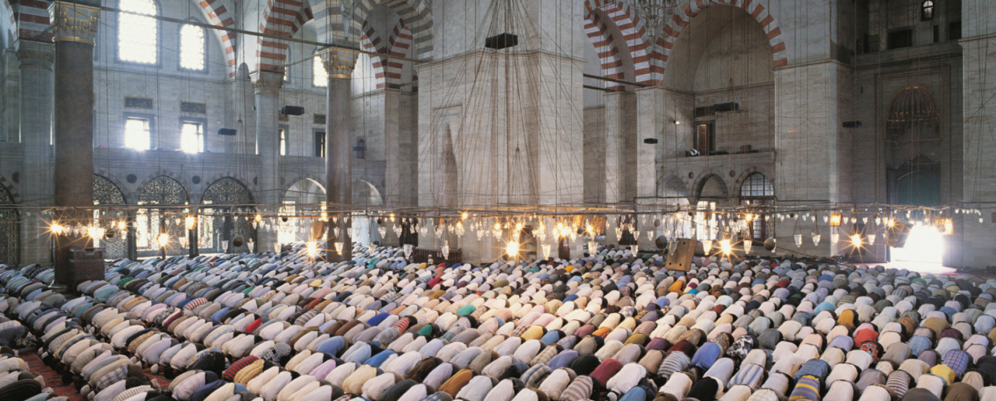
5 Pillars of Islam: Orthodox Beliefs & Practice
1. Declare (Shahada): “There’s no god but God and Muhammad is his Prophet”
2. Pray (Salat): 5 times/day facing Mecca; assembly for recited prayer Fridays midday
3. Alms (Zakat): 2.5% of income to poor – especially widows and orphans

Slide 11
Pillars continued
4. Fasting (Sawt):
1 month – 9th month of Islamic calendar (Ramadan)
Honors 1st revelation in Qu’ran from Muhammad
Fast each day
Okay to eat at night
Month’s end feast: Festival of Eid-Al-Fitr
Tablets of Abraham, Torah, Psalms, Gospels all in same month
Punished in some countries for not observing
Iran – non-Muslim had lips burned; others public flogged for eating
Kuwait – fine
Algeria - prison

Slide 12
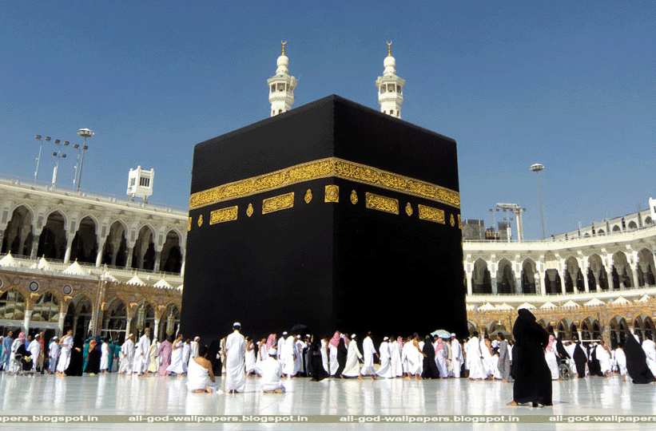
Pillars continued
Hajj (pilgrimage) once in life
to Mecca
Ka’bah: box in the middle of the central mosque in Mecca
Supposedly built originally by Abraham & Ishmael
Originally contained idols of local gods
Most sacred place of Islam
Contains the Black Stone
Stone Adam was given by God to absorb sins
Now is black with all of the sins of the world

Slide 13
“6th Pillar”: Jihad
“Struggle” or “Effort” in Arabic
Not formally observed
Different interpretations
Promote right and prevent wrong
Call for physical warfare
Presere
Spread dar al-Islam (political rule of Islam)
Self-defense
“God loves not aggressors”
Internal spiritual struggle to be devout

Slide 15
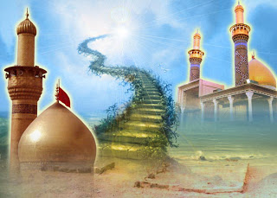
After death:
Devout
Paradise
Reject
Burn in hell
Free will is limited
God has all power

Slide 16
Shari-a: Islamic Law
Based in Qu’ran and Hadith
Similar to Jews
Proper conduct
Promote right
Prevent wrong
Law of society
Day to day
Eat, dress
Marriage
Men obligated to support wives
Up to 4 wives okay

Slide 17
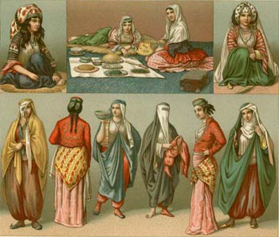
Women:
Question if worse before
Because of Islam or because of exposure to other cultures?
Byzantine:
Veil
Marriage/divorce practices
Economic status
Qu’ran
Men over women
Dress code because seen as seductive

Slide 18
Shi’as
Believe in religious purity
Caliph – represents religious principles
Not imperial
Only descendents of Ali as imam
Ali – son in law and cousin of Muhammad
Ali was by divine appointment
Special authority over people
Imam – right caliph
Hereditary line
Just Imam has already been here and will return

Slide 19
Sunnis
Follow Prophet’s example
Imam
Descendents of Abu Bakr
Father in law of Muhammad
Just Imam is yet to come

Slide 20
Differences
Imam: Ali’s descendents
“rightly guided one” already has been & will return
Imam by divine appointment
Imam must be pure
Knowledgeable, brave, wise, just, pious
Special authority
Imam: Abu Bakr’s descendents
“rightly guided one” yet to come
Imam can be elected
Ok is sinful b/c God appoints
Can’t rise up against Imam even if unjust
Shi’as
Sunnis

Slide 21
16% of Muslims worldwide
Iran – 95%
Iraq 60%
Pakistan
Poorest people in Sunni governed country
Discrimination
Clearer religious hierarchy
Ayatollahs – clerics for law
83% of Muslims worldwide
Less religious authority
Sunna: religious teachings of Muhammad
Shi’as
Sunnis

