Slide 1
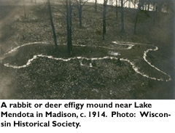
Mound Builders Mounds overview

Slide 2
Who Built the Mounds?
2 answers depending on who you ask
Oral tradition & archeology
Built by Native Americans
“Mound Builders”
Vanished race
Non-Indian
“10 Lost Tribes of Israel”
Vikings
Britons
Hindus
Others

Slide 3
Evidence
165 yrs of research
Big question: what tribes built them?
Built over span of 2500 yrs
Stopped building 200 yrs before Europeans asked
Only answers – from Ho-Chunk & Iowa
Ancestors of Ho-Chunk, Ioways, Dakotas, Missouris
No certain answer

Slide 4
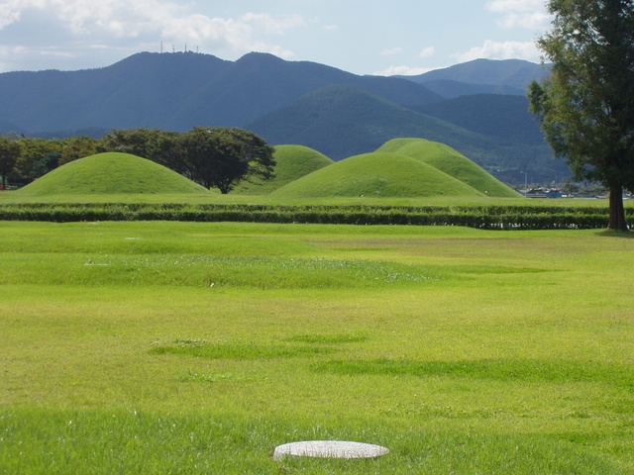
When?
350-2800 yrs ago
1500 mounds
Shapes?
Conical
Ovate
Linear

Slide 5
Effigy Mounds
1000-1300 yrs ago
Why called “effigy” mounds?
Form of animals: birds, bears, turtles, deer, etc.
Human form – rare
Largest – Both have been destroyed
Hemispherical (conical)
Richland County
200 ft diameter
Bird with ¼ mile wingspan (same area)
Largest today – bird at Mendota State Hospital with 624ft wings

Slide 6
What’s inside??
Burial
Most – single burial
Some – many in a shallow pit
Structures inside – unsure of purpose
Stoned lined
Charcoal layers
Ash
Burnt soil
Different colored soil
Rare to find artifacts
Typically everyday things
Arrow heads/spear points
pottery

Slide 7
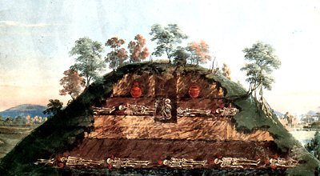
How did they build them?
Piling & packing dirt into shape
Some on prepared surface – cleared sod
Dug into the shape
Half mound is actually underground

Slide 8
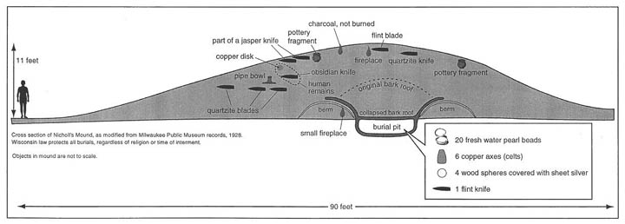

Slide 9
What do the shapes mean?
Controversy since 1838
Animals – represent clan emblems
Clan – social group with 1 common ancestor
Structure of society
Who marries whom
What societal roles are
Present day archeologists
3 categories
Fly (Upper World)
Walk (Lower World)
Water (Lower World)

Slide 10
Possible to mean multiple things
Clan
Symbolize the world
Mark territory
Mark landscape for resources
Changed over 300-400 yrs
Don’t know
Maybe doesn’t matter because we will never know?

Slide 11
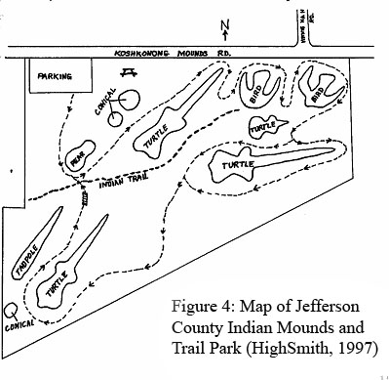
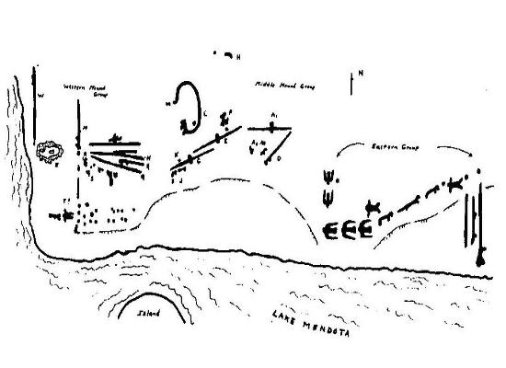
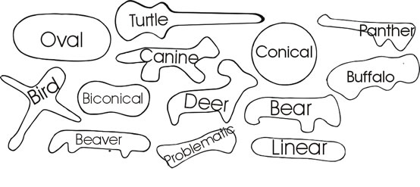

Slide 12
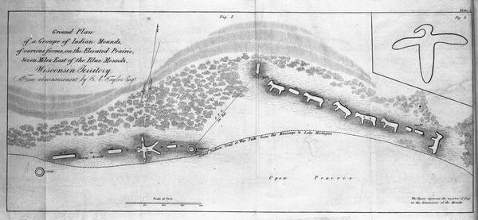

Slide 13
Where are they?
Throughout US
Highest number in Midwest
Majority in southern WI
Scattered in clusters or mound groups
Madison – Super Clusters
Also – Muscoda and Prairie du Chien
Bluffs, ridges, bottom lands, shorelines
Resource rich areas
Areas where there would have been larger groups of people
Other natural features – marshes, springs, caves

Slide 14
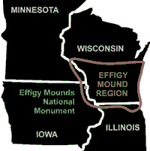
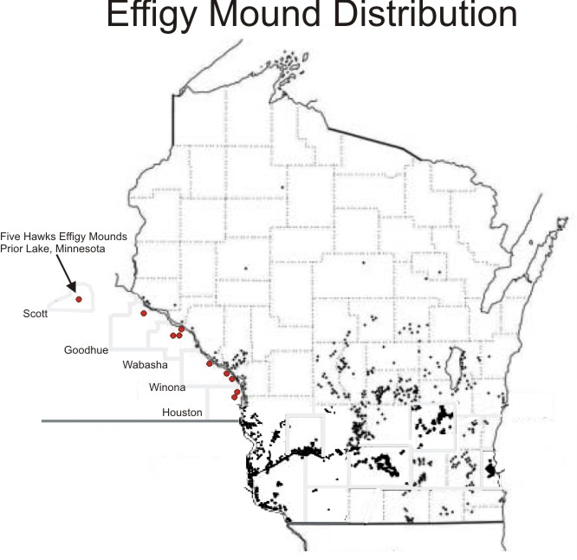

Slide 15
Distribution of mounds in WI
Birds – more in western WI
More high ground in west?
Bluffs, hills
Panther & water spirits – more in eastern
Lakes and marshes

Slide 16
How did Native People pick a spot?
Examine where they are placed
11 mound groups are/were on UW Madison campus
8 of 11 ridge tops over Lake Mendota or Lake Wingra
3 of 11 near marshes or lakes
Chosen because of proximity to water?
Elevated
Unobstructed view
Aesthetics

Slide 17
Why stop?
Between 900-1000 yrs ago stopped
Changes to way saw selves in society?
Mounds in general continued till 1600s
Stopped during European exploration
migrations

Slide 18
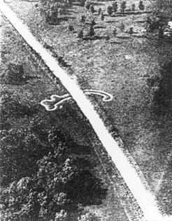
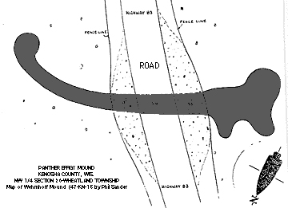
Why were they destroyed?
Plowed under
Buildings and roads
During archeological explorations
reconstruction
Panther- Kenosha

Slide 19
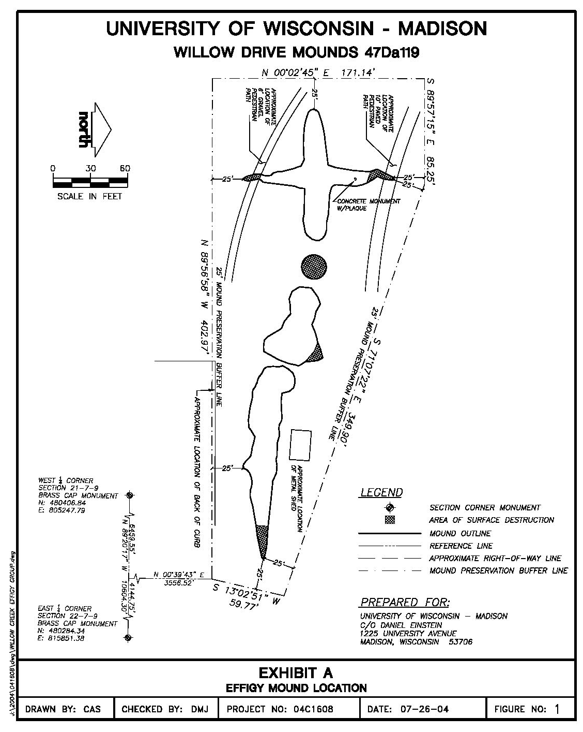

Slide 20
Status today
Considered human burial sites
Protected on non-federal lands
WI Burial Sites Preservation Law (Wis. Stats 157.7)
WI Field Archaeology Act (Wis. Stats44.47)
Federal or Tribal lands
Protected by Archaeological Resources Protection Act
Native American Graves Protection and Repatriation Act
Ethics – leave be and wait till technology can give us information rather than digging up

Slide 21
Proposed AssemblyBill 620 Channel 15 news story Ho-Chunk perspective 1/12/2016 Pow Wow Protest
Allow landowners to excavate and develop on some mounds
Senator Kapenga (R -Delafield)
Representative Brooks (R – Saukville)
Private property rights rather than historical preservation
Backers –
Wisconsin Manufacturers & Commerce
Wisconsin Builders Assoc.
Wingra Stone & Redi-Mix quarry near McFarland
Effigy mound is blocking excavation access
Bill – need WI Historical Society permit
If no remains, ok to go ahead and dig

Slide 22
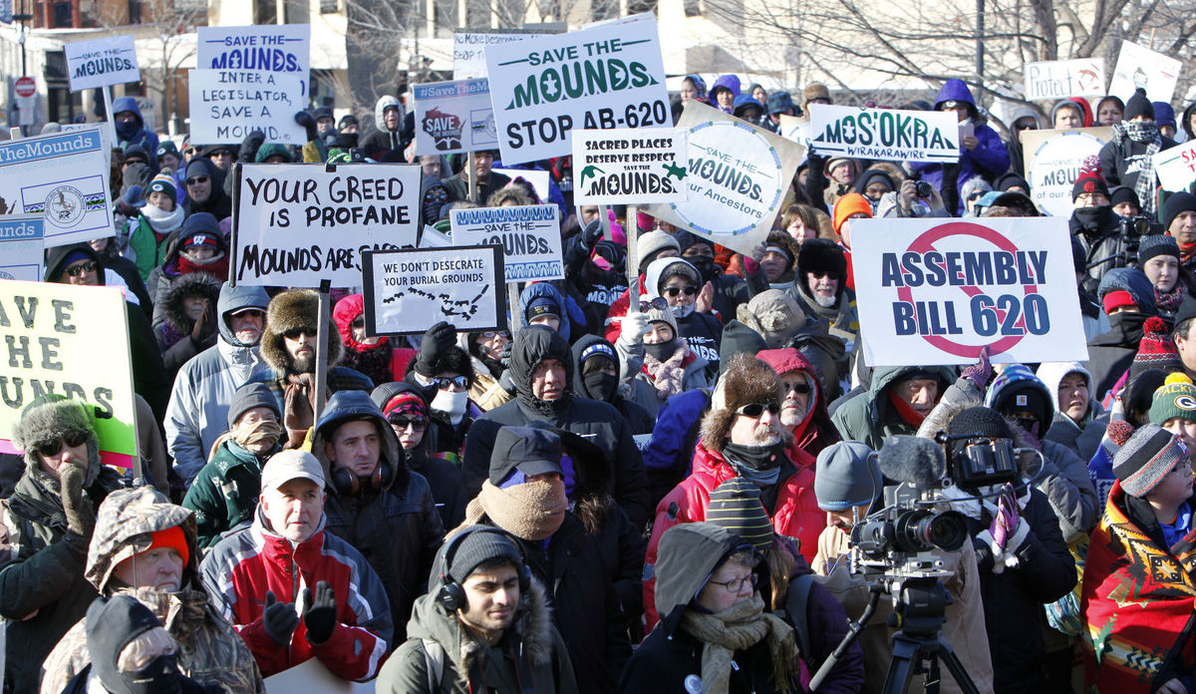
Rationale – private property won’t overlap with mounds
Pushback –
Ho-Chunk nation
Rallies
Remains may have decomposed
Regardless, sacred

Slide 23
To think about…
Older than the Egyptian Pyramids
Sacred burial sites all over the world –
Chinese Emperor Shihuangdi mound
UNESCO World Heritage site
Ruins of Greece and Rome
Bird effigy on Wingra Stone site is last of 7 in the Ward Mound Group of Ho-Chunk Nation

