Slide 1
TODAY:
Do now: Write 1 of our classroom discussion rules
Quick review of rules
Opinion cards
Write down initial opinion on Washington Redskins name debate on the back of the opinion card that you agree with
Slide show and discussion
Split into groups (of 2 or 3) for jigsawing short readings, write 3 key points you took away from the readings
Quick share of readings: read summaries to class (I will compile and give you a handout for your notes tomorrow)

Slide 2
9. Video (if time)
10. Exit ticket quick write on back of opinion card: Have you changed or maintained your opinion? Why? (3-5 sentences) Hand in entry and exit response.
11. Homework: Journal about today’s lesson. Journals will be collected at the end of the week. Add to your current definitions of the semester terms. Do you think your interpretations of the terms has changed? Explain why. If you have more to add, do so. Date and label your entries (i.e. 11/21 Native American Unit) See me with questions or refer to the sample journal on my desk.

Slide 3
KEY WORDS WE WILL DEFINE THROUGHOUT YEAR:
ETHNICITY EQUALITY
RACE PERCEPTION
RACISM PERSPECTIVE
DISCRIMINATION STEREOTYPE

Slide 4
Essential Questions: Is it ever okay to use a particular depiction of a race or ethnicity in propaganda? Why or why not? When? How can perspective influence one’s impression of imagery? Purpose: We will be able to examine various marketing images and determine whether they convey a positive or negative representation of a race. We will be able to recognize what may perpetuate racial stereotypes. (Write on new page in your journal)

Slide 5
Racism or respect:
The Native American Mascot Debate

Slide 6
Should the Washington Redskins change their name?

Slide 7
Does this honor Native Americans?

Slide 8
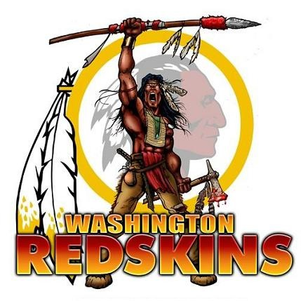
Does this?

Slide 9
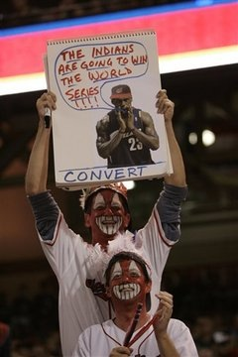
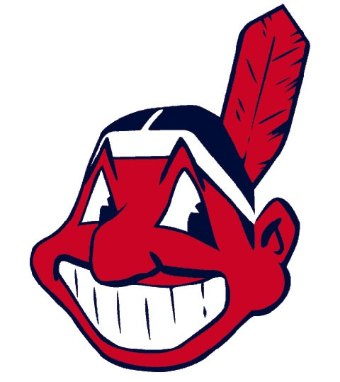
And what about this?
MLB Cleveland Indians Chief Wahoo

Slide 10
The creator of the Cleveland Indian’s Chief Wahoo in 1946 wanted a mascot that "would convey a spirit of pure joy and unbridled enthusiasm“. Does Chief Wahoo do this?

Slide 11
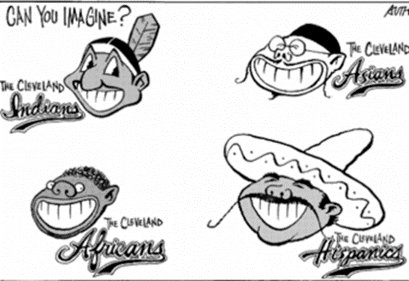
What if we think about this in terms of other races? Would it be “okay”? How would people react to these images?

Slide 12
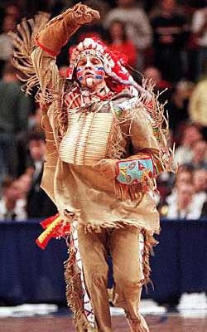
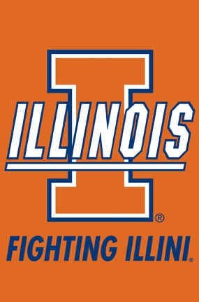
NCAA termed Chief Illiniwek a "hostile or abusive" mascot and image in August 2005. IL retired “him” in 2007

Slide 13
Examples of Native American Team Mascots:
Chief Illiniwek of University of IL: Fictional character, played by white student wearing non-representational clothing and doing unauthentic dancing
Retired 2007
Chief Wahoo of Cleveland Indians: Cartoon character not considered a “mascot” but a “logo”
Still in use. Official mascot is Slider.
Chief Noc-A-Homa of Atlanta Braves: Portrayed at one point by an Odawa Indian
Retired in 1986
Imagery reappeared in 2012 on practice hats
Official mascots are Homer and Rally

Slide 14
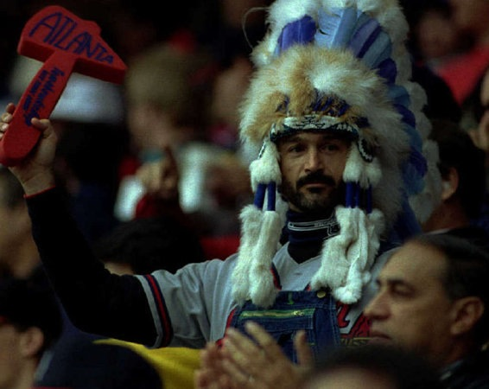
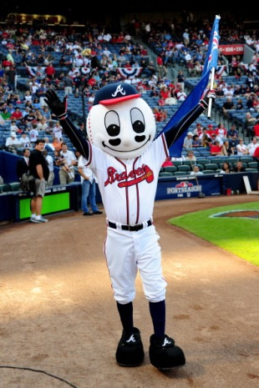
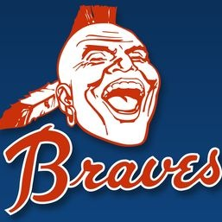

Slide 15
The “Exception”?
Chief Osceola of FSU Seminoles:
Have approval by tribal leaders of the Seminole Tribe of Florida, but not all other tribes of the Seminole Nation
Represents actual historical figure, costume designed originally by members of Seminole tribe
FSU officials insist Osceola is not a mascot but a symbol or image inspired by Seminole history
Historically has been played by white students
NCAA granted FSU permission to continue using Osceola as they do not consider him a "hostile or abusive“ use of Native-American names and imagery

Slide 16
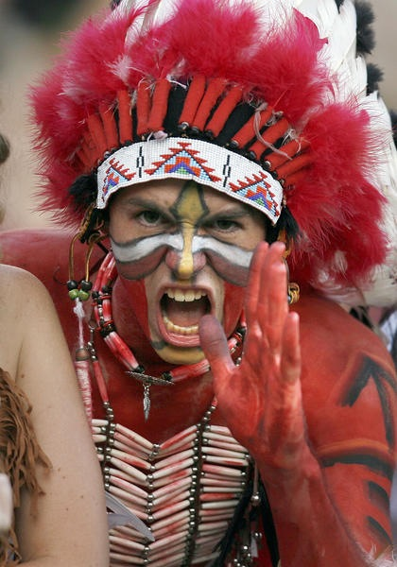
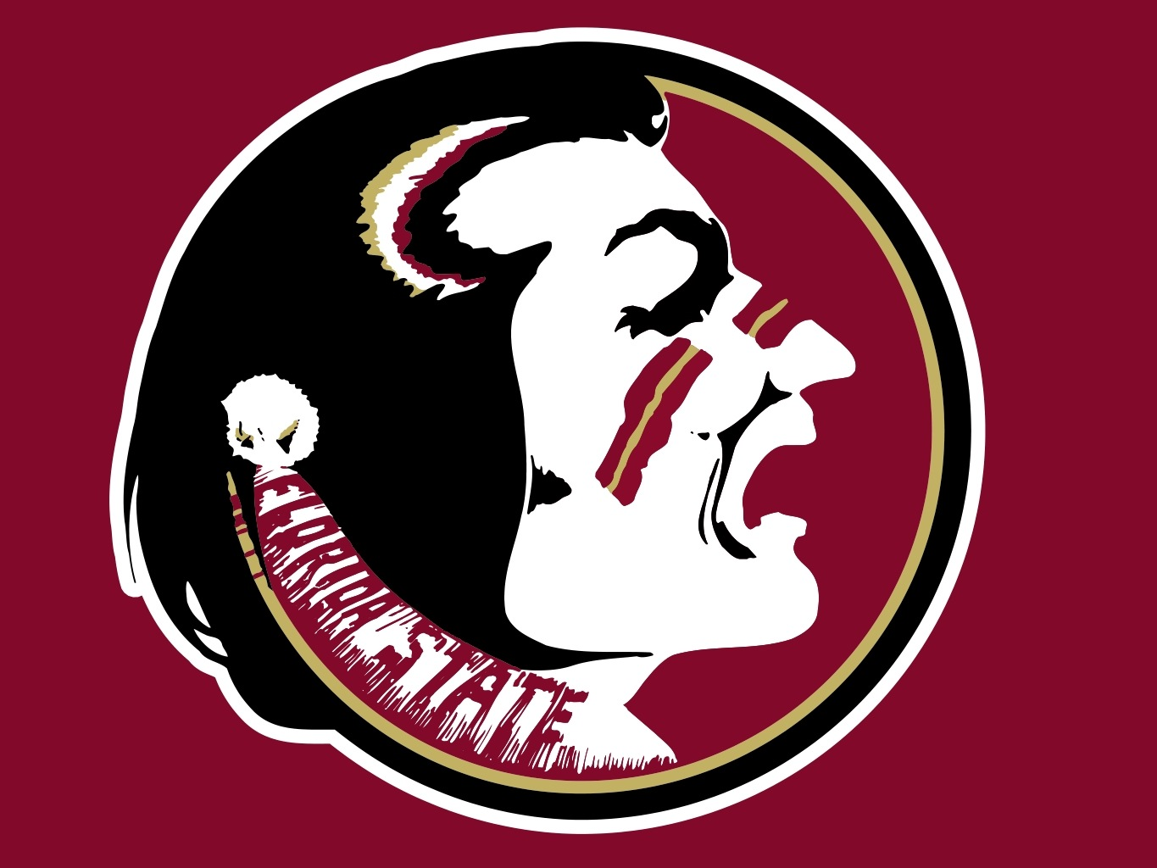
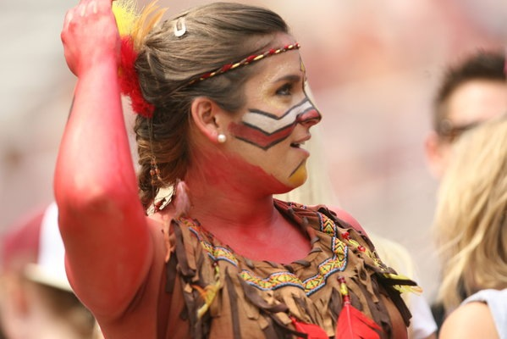
Florida State Seminoles: Mascot vs. Fan representation?

Slide 17
The NAACP passed a resolution calling for the end of the use of Native American names, images, and mascots in 1999.
In 2001, the U.S. Commission on Civil Rights released an advisory opinion calling for an end to the use of Native American images and team names by non-Native schools. The opinion made the following points:
The use of Native American images and nicknames in school is insensitive and should be avoided, and may violate anti-discrimination laws.

Slide 18
These references.. are particularly inappropriate and insensitive in light of the long history of forced assimilation that American Indian people have endured in this country.
It is particularly disturbing that Native American references are still to be found in educational institutions ... where diverse groups of people come together to learn not only the "Three Rs," but also how to interact respectfully with people from different cultures.

Slide 19
The use of stereotypical images may create a hostile environment that may be intimidating to Indian students. American Indians have the lowest high school graduation rates in the nation and even lower college attendance and graduation rates. The perpetuation of harmful stereotypes may exacerbate these problems.
Schools that continue [these practices] claim that their use stimulates interest in Native American culture and honors Native Americans but have simply failed to listen to the Native groups, religious leaders, and civil rights organizations that oppose this behavior.

Slide 20
Mascots, symbols and team names are not accurate representations of Native Americans. Even those that purport to be positive are romantic stereotypes that give a distorted view of the past. These false portrayals prevent non-Native Americans from understanding the true historical and cultural experiences of American Indians. Sadly, they also encourage biases and prejudices that have a negative effect on contemporary Indian people. These references may encourage interest in mythical "Indians" created by the dominant culture, but they block genuine understanding of contemporary Native people as fellow Americans

Slide 21
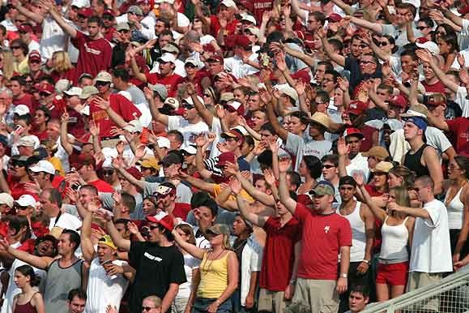
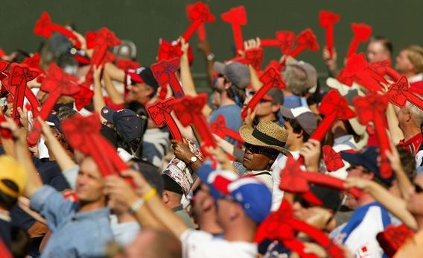
Accurate?
Respectful?
TOMAHAWK CHOP?

Slide 22
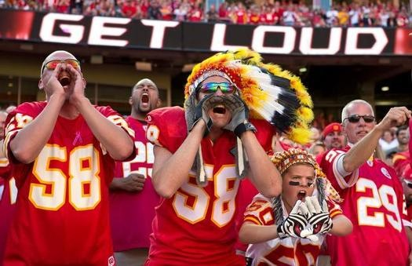
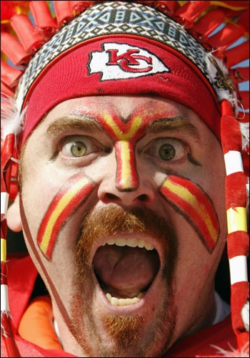
What about the fans? Is this disrespectful? Does it perpetuate stereotypes? Does it affirm them?

Slide 23
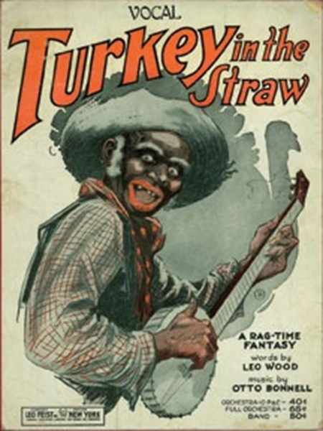
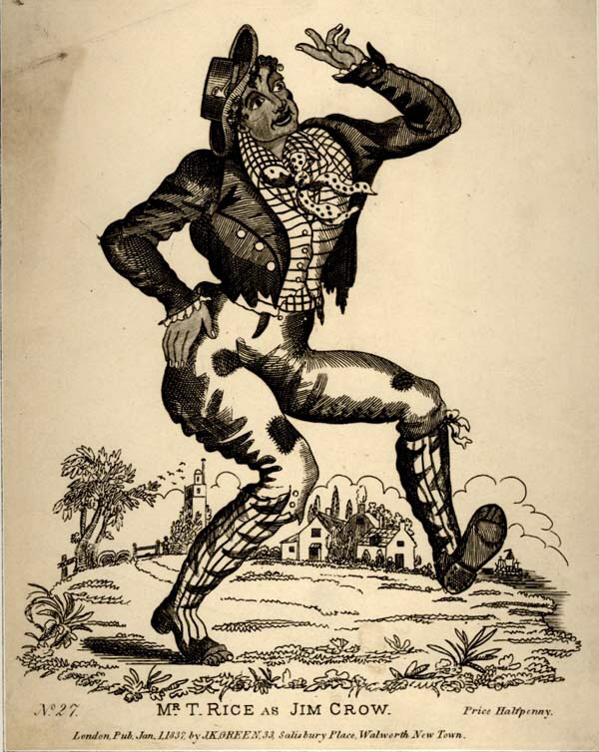
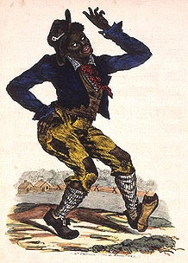
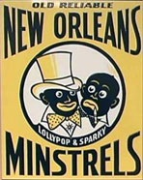
When is it okay to dress as another race?

Slide 24
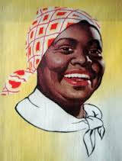
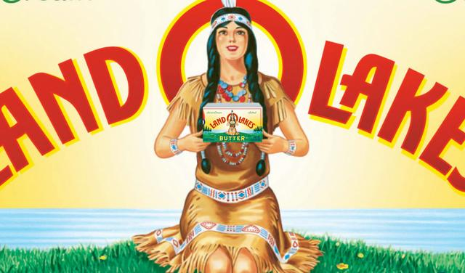
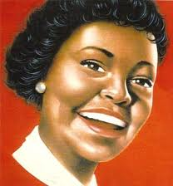
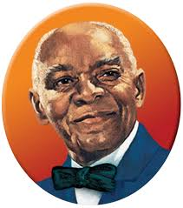
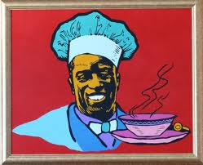
Racial images are all around us and we probably just dismiss them. Is this okay? What does it say about racial perceptions?

Slide 25
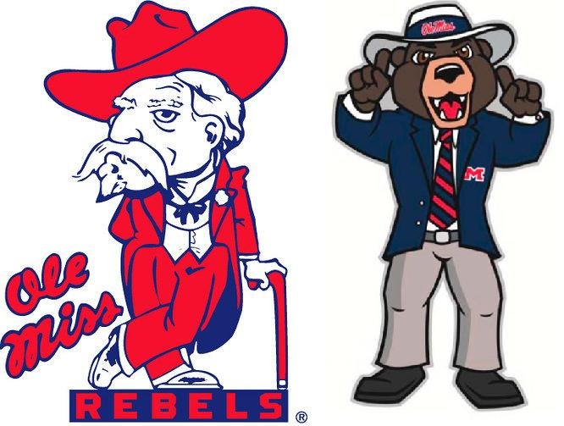
The other end of the spectrum: Colonel Reb from University of Mississippi is now retired because he appears to represent a southern plantation owner and replaced by the Rebel Bear. ‘Ole Miss’ is itself the nickname of a slave owner’s wife.

Slide 26
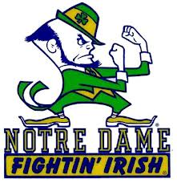
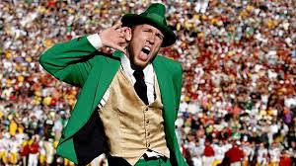
Is this discriminatory?

Slide 27
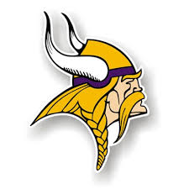
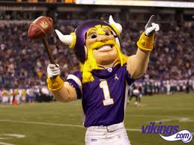
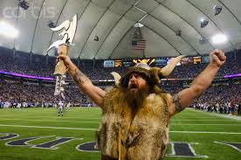
Or this?
Why?

Slide 28
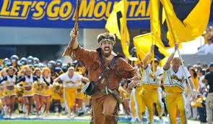
And what about this?

Slide 29
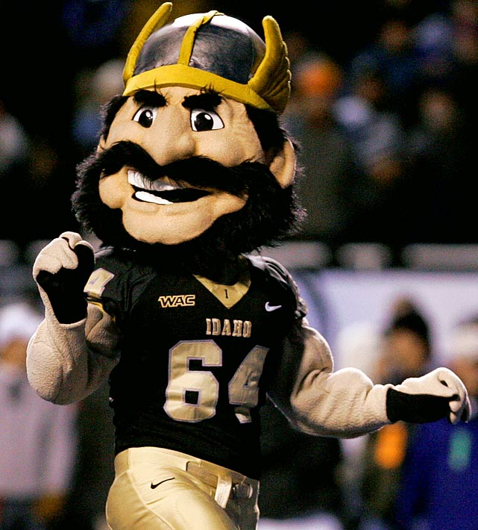
What’s the solution?
University of Idaho Vandal

Slide 30
http://www.indianmascots.com/
Currently in Wisconsin, a mascot bill is on the table and supported by the Governor. It would make it okay for schools to continue to use their Native American mascots.
http://www.startribune.com/politics/national/232260011.html

