Slide 1
Big Era Six: 1400-1800 C.E.
The Great Global Convergence: Shifting from an Asian-centered trading system to an Atlantic-centered system
‹#›
Notes:
‹#›

Slide 2
The Great Global Convergence
The Great Global Convergence
Big Era Six lasted from 1400 to 1800 CE.
Today
Era 3
Era 4
Era 5
Era 6
7
8
9
‹#›

Slide 3
What was global convergence?
Change accelerated when people, resources, and ideas from the whole world came together making it more like the world today.
Converge means to come together.
Accelerate means to speed up.
‹#›

Slide 4
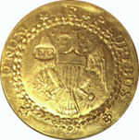
Exchanges that began in Afroeurasia during Big Era Five continued to bring about change.
Scholars translated books, taught others, and worked to gain knowledge.
Trade introduced people to new products, increasing the demand for luxuries.
Money moved across countryside and continents in exchange for goods.
‹#›

Slide 5
Religious ideas were hotly debated, and missionaries spread religions to new lands.
Ruling groups debated laws, and military struggles continued.
‹#›

Slide 6
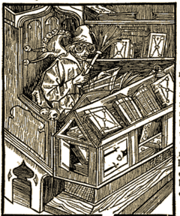
Printing technology spread from China to Europe. European and Korean artisans invented printing with movable metal type at about the same time.
Gutenberg’s printing press with moveable type could reproduce pages quickly, adding woodcut illustrations.
In the first century of printing, thousands of books were sold and added to Europe’s growing libraries.
‹#›

Slide 7
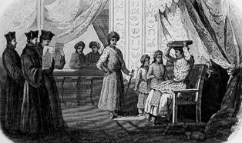
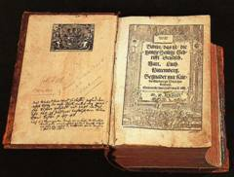
Religious institutions and ideas changed with the times
Martin Luther challenged the Catholic Church’s authority and brought on the Protestant Reformation after 1517. He translated the Bible into German.
Political leaders took sides, spawning European religious and national conflicts that lasted more than a century—to the mid-1600s.
‹#›

Slide 8
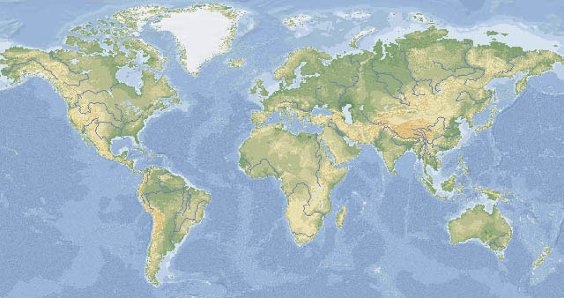
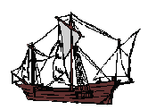
Slide 11
Vasco da Gama
1498
Columbus 1492
Magellan
1519
After 1415, European mariners made voyages across the seas toward east and west. By 1519, Spanish ships had circumnavigated the globe. Others set out in search of wealth and adventure.
‹#›

Slide 9
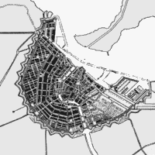
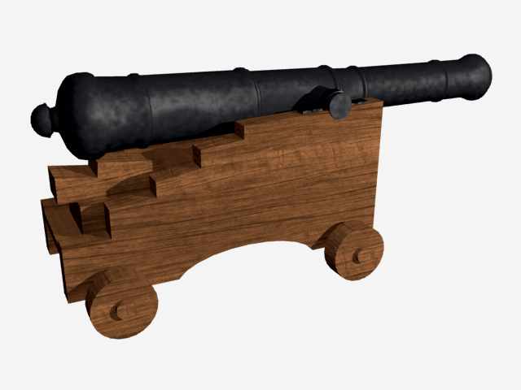
Slide 13
Global convergence sped up the dynamic of world change.
From 1400 to 1800 the rate of change accelerated more rapidly in many areas of human activity.
Population & Environment
Ideas & Inventions
‹#›
Trade & Manufacturing
States & Empires

Slide 10
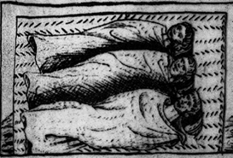
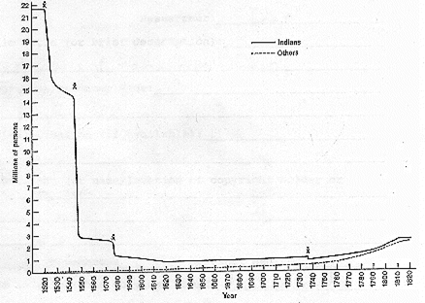
The Great Dying
The Great Dying was caused by smallpox and other disease germs carried by the conquerors. Native Americans had no immunity to these diseases.
By some accounts, the population of the Americas fell from 22 million in 1500 to less than 1 million in 1640.
‹#›

Slide 11
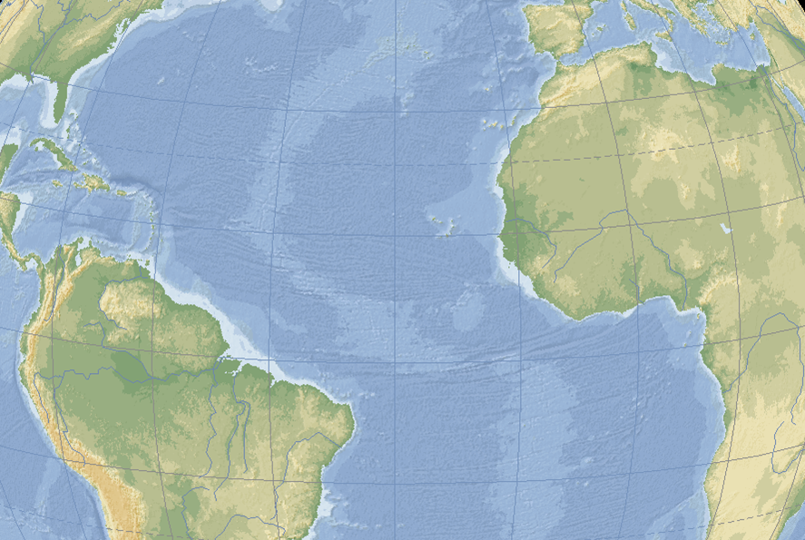
Slide 15
Europeans brought African slaves across the South Atlantic to labor in the colonies. The Atlantic slave trade grew from about 1,000 per year in the early 1500s to nearly 80,000 per year at the end of the 1700s.
‹#›

Slide 12
Slide 16
‹#›

Slide 13
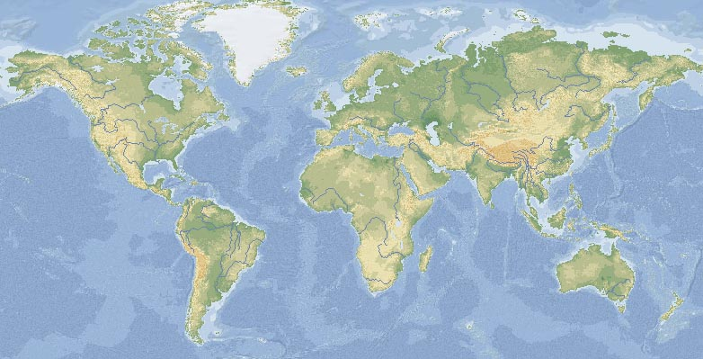
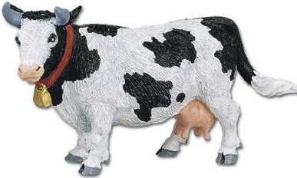
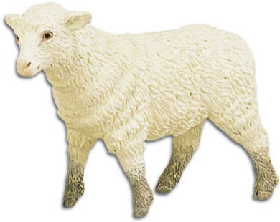
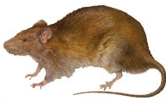
Slide 17
The Columbian Exchange
‹#›
Plants, animals, and micro-organisms of Afroeurasia were exchanged with those of the Americas across the oceans.

Slide 14
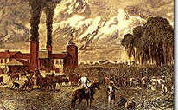
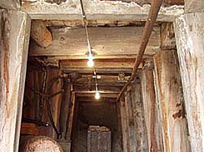
Slide 20
Deforestation intensified with growth in mining, shipbuilding, and plantation agriculture.
boiling sugar
mining
‹#›

Slide 15
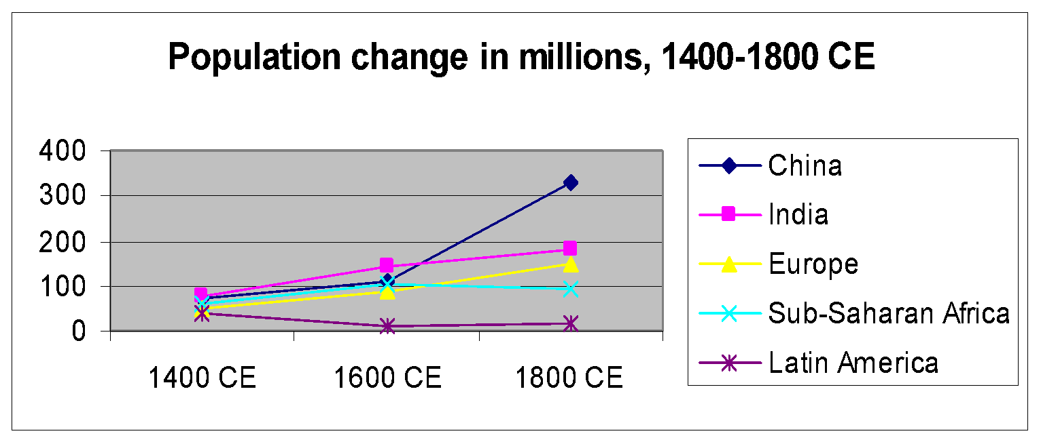
Slide 21
The number of people in the world increased about 2 ½ times between 1400 and 1800 CE
Growth differed among world regions.
‹#›

Slide 16
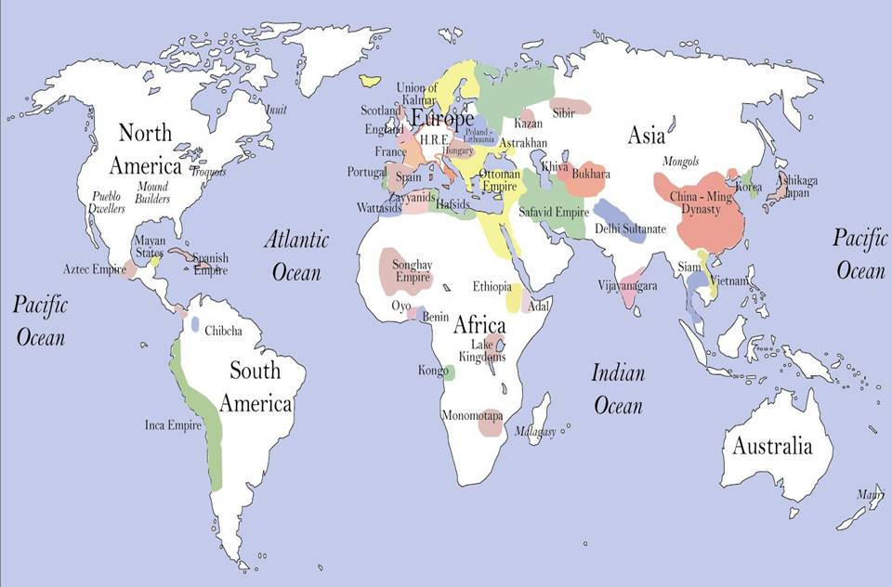
Slide 32
States and Empires in 1519 CE
‹#›

Slide 17
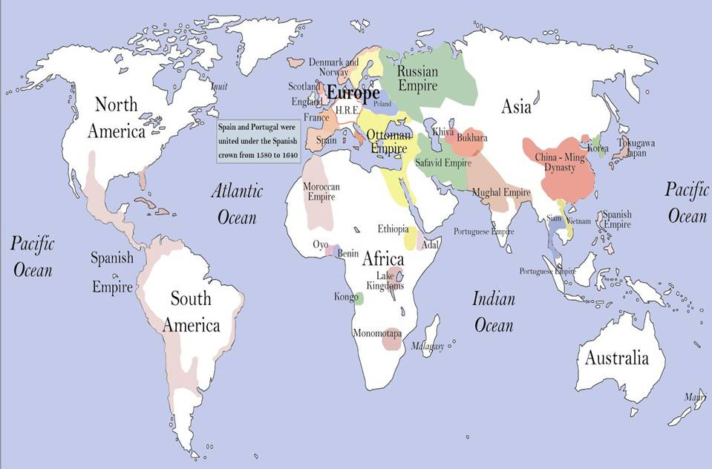
Slide 33
States and Empires in 1600 CE
‹#›

Slide 18
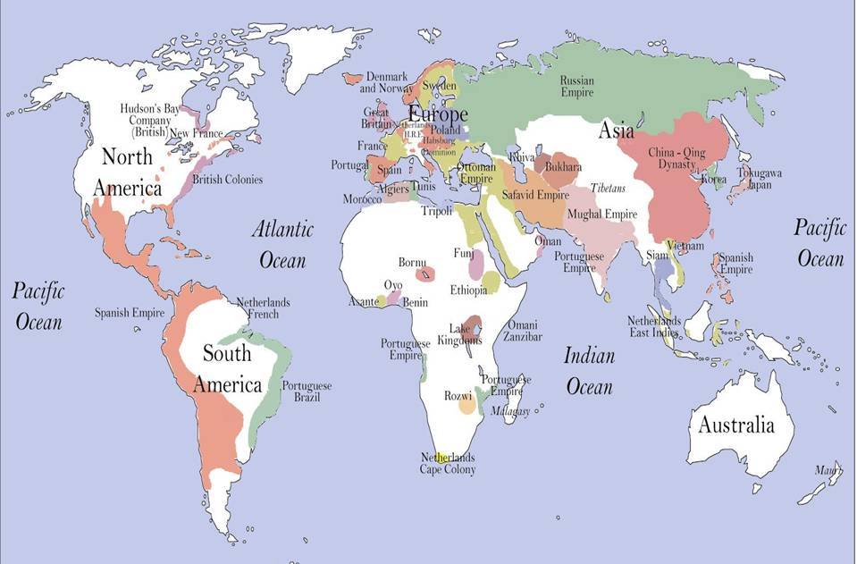
Slide 34
States and Empires in 1714 CE
‹#›

Slide 19
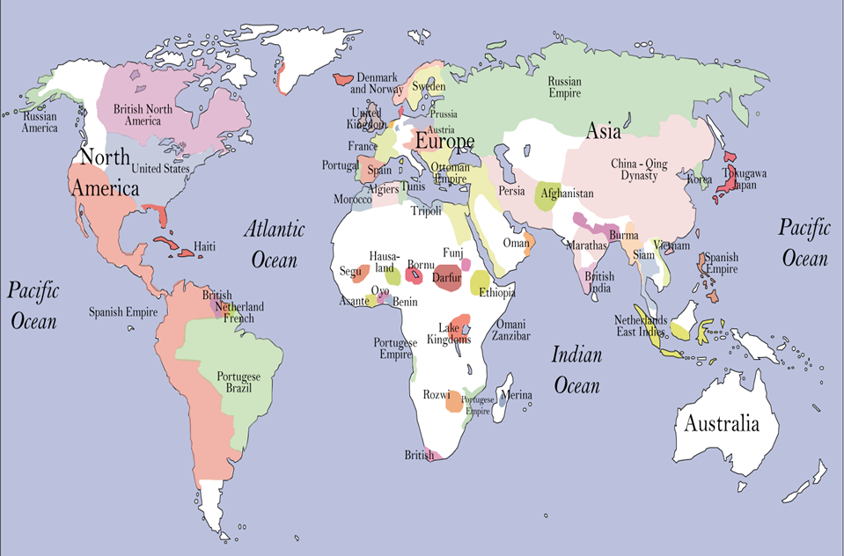
Slide 35
States and Empires in 1804 CE
‹#›

Slide 20
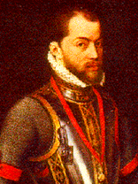
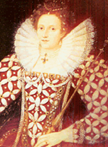
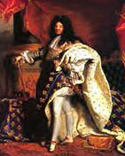
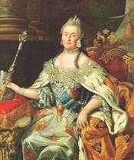
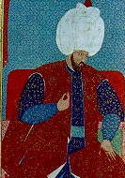
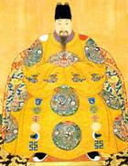
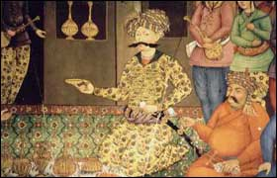
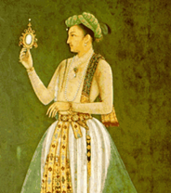
Slide 36
Monarchs claimed absolute power.
Philip II
Spain
1556-1598
Elizabeth I
England 1558-1603
Louis XIV
France 1643-1715
Catherine the Great Russia
1762-1796
‹#›
Süleyman Ottoman Empire 1520-1566
Xizong Ming China 1620-1627
Shah Abbas
Persia
1587-1629
Jahangir
India
1605-1627

Slide 21
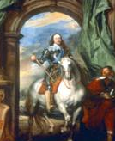
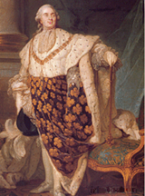
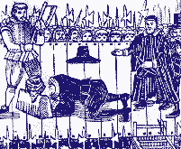
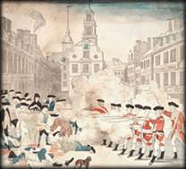
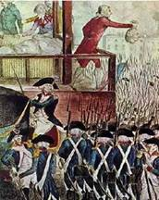
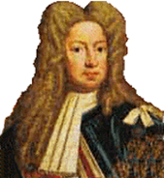
Slide 37
Challenges to absolutism came from new elites with ideas about human rights.
Louis XVI
1775-1793
Charles I
1625-1649
Charles I, beheaded in 1649
‹#›
King George III
1760-1820
Rebellion in American Colonies 1776
French Revolution
1789

Slide 22
Summary: global convergence led to accelerating world change.
Environmental change accelerated with the Columbian Exchange, intensified resource exploitation, and continuing deforestation.
World population increased owing to improved nutrition and migration. But Africa gained only slowly due to slavery, and native Americans suffered massive population losses because of Old World disease pathogens.
Science, technology and cultural development expanded with the invention of printing and new knowledge institutions—libraries, universities, and museums.
‹#›

Slide 23
World trade volume increased dramatically and began to shift its center from Asia to the Atlantic region.
States increased their power with gunpowder conquests and new sources of mercantile wealth.
In Europe rising economic elites enjoyed growing wealth, which led them to challenge old landed aristocracies and monarchs.
‹#›

