Slide 1
Before we were the Badger State

Slide 2
So What? Post French & Indian War
No Difference
British took over fur trade
By 1770 beaver were depleted
Native American dependency on European goods
Lost survival skills
Specifically alcohol and guns

Slide 3
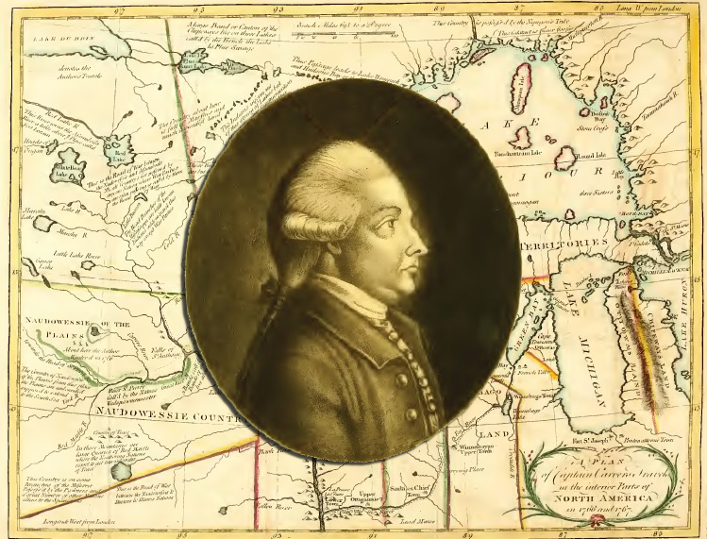
Canoe
- Fox River Wisconsin Waterway
1st Anglo-American (not French)
Prairie du Chien (1766)
Rendezvous point for Native Americans
Fox Indians
Goal to find a northwest passage to Pacific
Captain Jonathan Carver

Slide 4
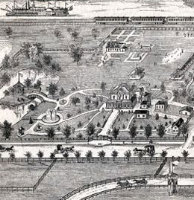
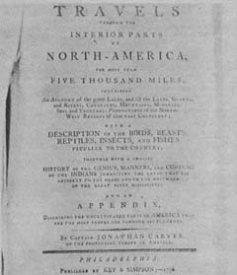
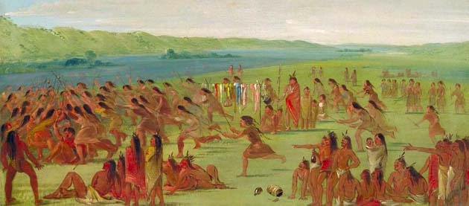

Slide 5
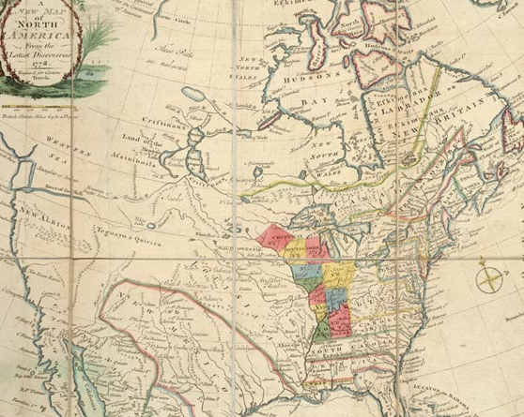

Slide 6
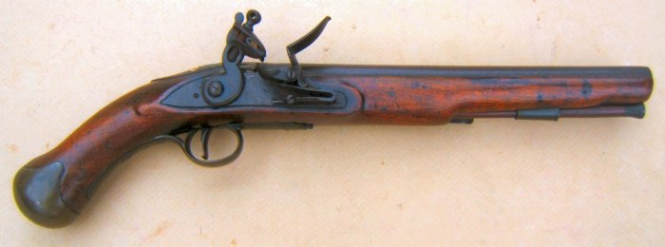
So What? American Revolution
No significant impact west of Lake Michigan
British gave gifts and ammunition to Native Americans
Also more settlers going west = threat
Less okay with the Americans
Sided with French
Also had no real connection with Americans economically
Only military authority
Green Bay (British)

Slide 7
1785: Divide and Conquer?
Congress decides to survey and sell land from Ohio River to Mississippi Rivers (WI included)
Grid of 6 X 6 mile sections based on latitude/longitude lines
160 or 320 acre plots
SLOW process – WI not surveyed until 1830s
Squatters

Slide 8
Northwest Ordinance of 1787
Plan for statehood after a period of “colonial rule”
Can have own legislature if pop is 60k+
1. voted on by men
2. draft a constitution
3. petition for admission to the Union
1st was Ohio (1803)
Last Wisconsin (1848)

Slide 9
More settlers = more battles
Indian battles increased
US Army sent in to push back

Slide 10
Read the fine print…
It starts…
British had used bribes of $ and whiskey
Americans continued this
1804
Sauk chiefs negotiate release of Sauk man accused of murder
Duped: Signed away land along Mississippi between IL and WI Rivers for $1000/yr

Slide 11
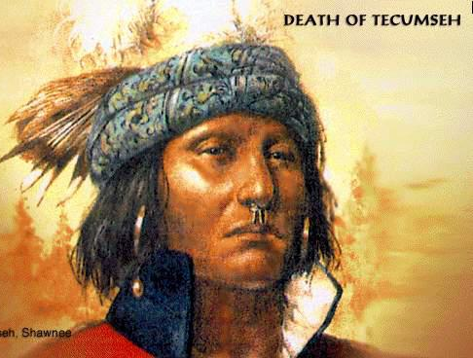
Tecumseh
Shawnee chief
Pushed from Ohio
Alliance of NW tribes
Brother: “The Prophet”
Preached – reject whiskey and gambling
Indians will come out on top
Chippewa joined

Slide 12
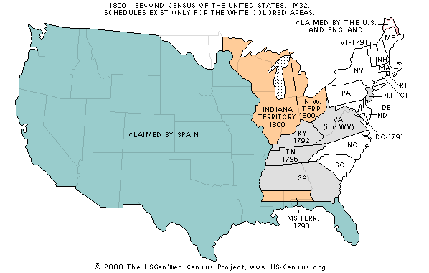

Slide 13
Tippecanoe Creek (1811)
Governor William Henry Harrison (future 9th president) of Indiana Territory
Attacks Northern Indiana Territory while Tecumseh out
Indians fought and fled to woods
1st shot of War of 1812 between Americans and British
Harrison found crates of guns from the British

Slide 14
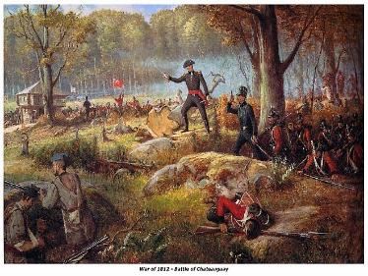
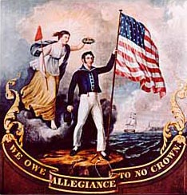
WAR of 1812

Slide 15
June 1812: Congress declares war on England
Tecumseh allied with British
WI tribes joined
French
Canadians, Sioux, Winnebago and Menominee
Forts in Detroit and Mackinac surrendered easily
Sauk and Fox join
Massacre at Detroit
August 1812: Tecumseh has 1k+ warriors
Americans lost North and West of Fort Wayne, Indiana
Americans in Prairie du Chien
Fled
Winnebagos plundered

Slide 16
War of 1812 in 3 min
War of 1812 Crash Course
War of 1812: Native Americans (56 min)

Slide 17
1813 General Harrison led counter attack
Green Bay: Canadian Fur Trader Robert Dickson gathered
Menominee (Chief Tomah)
Winnebago and Sioux
Sauk (Chief Black Hawk)
British Commander at fort hid
Tecumseh killed
Morale down (British losing – Andrew Jackson victories in south)
Peace treaty: December 1814
No more English presence in WI

Slide 18
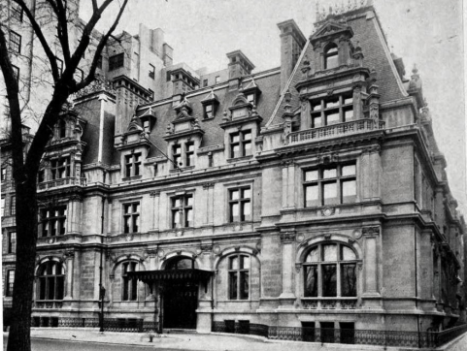
Bumpy path to statehood
IL: State in 1818
WI was part of IL Territory; not part of Michigan Territory
2 white settlements with forts: Green Bay & Prairie du Chien
Economy centered still on fur trade
limited beavers left: fox, bear and raccoon
American Fur Company (John Jacob Astor)
Move to land speculation for more $$

Slide 19
Gimme your land!
Increased population = increased demand for land
Population west of Lake Michigan
1820: 651 civilians/804 military
1836: 11,683 people
No more Tecumseh: confederacy fell
Native Americans still owned land
Government took from Winnebago
Winnebago attacked settlements
Now a “justification” for the army to come
PBS: War of 1812 short

Slide 20
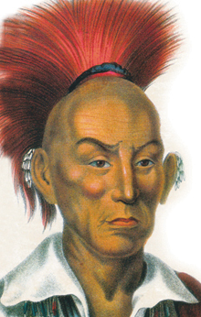
1829 (Not so) Great Cession
Conference in Prairie du Chien
Sauk and Fox b/c of mining push
Last Indian Conflict east of the Mississippi
Black Hawk’s War
Most Indians moved to west bank of Mississippi to hunt; lost east bank (where farmed)
Black Hawk – stayed till 1831
Winter was hard (b/c didn’t harvest crops on east bank)

Slide 21
Black Hawk’s War
Black Hawk w/1k warriors crossed the river
Reclaim village
Military got wind of
General Atkinson
Rock River – new fort
Black Hawk joined the Prophet’s Winnebago and north to Potawatomi village
Limited food
Not committed to joining Black Hawk

Slide 22
Stillman’s Run
Black Hawk’s men entered an IL camp with a white flag to surrender
Farmers in the fort ran away
No one there to accept the surrender
Lead men from Rock River to Yahara river way
To Four Lakes (current day Madison)
Chased out by Commander Dodge

Slide 23
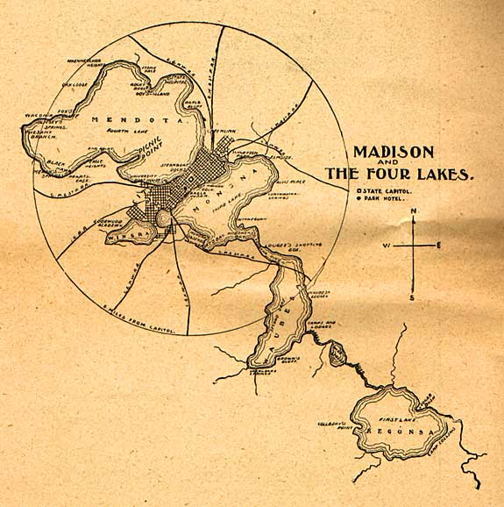

Slide 24
The Fall of Chief Black Hawk
Fled to Wisconsin River then Mississippi River
Built Rafts
Had white flag
Steamboat “Warrior” opened fire on Black Hawk’s troops, men, women and children
Rest fell at Battle of Bad Axe Creek
Black Hawk surrendered to Winnebago who turned him over to the army
St. Louis base of Lt. Jefferson Davis (later President of the Confederate States of America during Civil War)

Slide 25
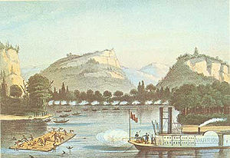

Slide 26
Resettlement and Displacement
(1832-33) Government forces tribes – even those who did not join Black Hawk – to sell land
Winnebago, Potawatomi, Menominee, land south and east of Wisconsin River, then land south of Lake Superior and east of Mississippi River
1837 and 1842 treaties with Sioux and Chippewa
Sioux joined others in Dakotas
Chippewa – reserve lands
1833 – Land Office in Green Bay
Auctions land at $1.25/acre minimum

Slide 27
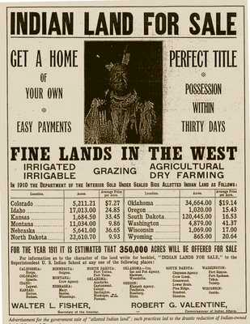

Slide 28
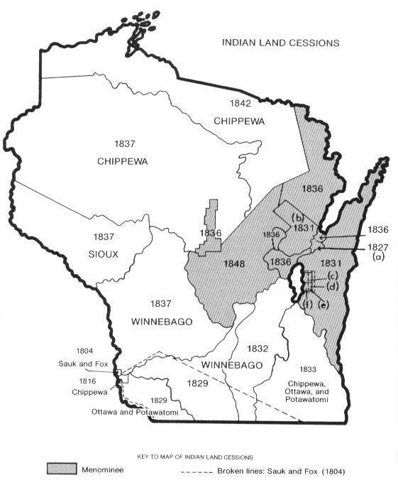

Slide 29
